Slide 1

AIC – Analog Integrated Circuits
Low Power LDO
Neeraj Mishra

Slide 2
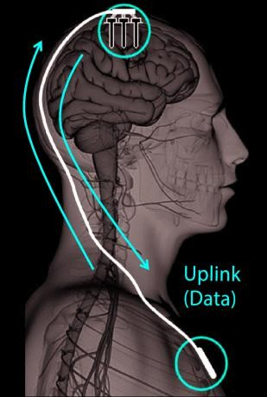

The starting point…
Introduction
The following project starts from an IEEE article* about the needing for an energy efficient wired interface for biomedical multi-implant devices.
The basic concept is to design an integrated chip capable of handling both communication and power sharing between an Uplink (coming from the slave sensors implant) and a Downlink (coming from the master chest implant with integrated battery).
The chip has been fabricated by using the ON C35B4 5V compliant technology and presents very low power consumption, requiring a 91.2 µA quiescent current.
The following project is about a re-design of the integrated LDO exploited in the above mentioned article by using the ON C5N technology.

Slide 3
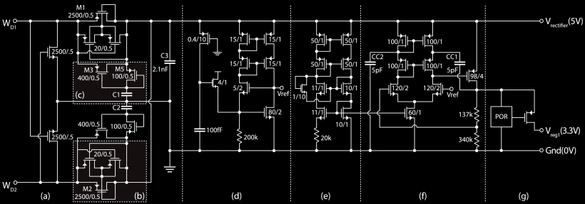
Introduction
Project structure
The circuitry in the box is the part of interest and it consists of an LDO stage (f) implemented with a PMOS pass-transistor topology, a BIAS generator (e) exploiting a β multiplayer approach and a voltage REFERENCE (d). These three circuits have been designed and implemented at schematic level while the voltage reference has been completed with two layout versions.
Power-On-Reset circuit has a logic which monitors the regulator output enabling the final transistor when needed.
Passive full-wave rectifier with charge-storage technique. It allows the extraction of a DC 5V supply from the Downlink square wave signal.

Slide 4
Introduction
Project structure
Current budget
Current budget
Since the total current of the IC is about 92 µA, the budget for the considered power section has been set to ¹/₃ of the total which leads to about 30 µA of available current. The latter can be rationed as follows:
12 µA for the entire LDO stage ( 8 µA for the resistors branch and 4 µA for the differential amplifier);
8 µA for the voltage reference (4 µA per branch) which is an important part of the design for
DC PSRR performances;
the remaining budget is to supply the bias circuit (8 µA) and to keep a safety margin about possible variations.
Having in mind the above limits, the design can start from the LDO power stage and its differential
amplifier.

Slide 5
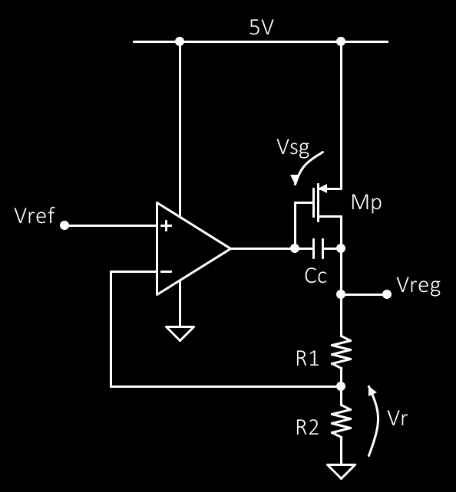
LDO design
Introduction
Project structure
Current budget
LDO design I
The specification is to design a 3.3 V regulator capable of delivering
up to 2 mA current to the load.
To design R1 and R2 it is requested the specific about quiescent current of the branch. Since the current assigned to the resistors branch is 8 µA, the total resistance value is given by:
3.3 𝑉
𝑅 = _{8 𝜇𝐴} = 412.5 𝑘Ω
The feedback voltage depends on the resistors partition ratio and it sets the 𝑉_{𝑟𝑒𝑓} value too. In this work it has been chosen a ½ factor then the two resistors must have the same value:
412.5 𝑘Ω
𝑅1 = 𝑅2 =
≅ 206 𝑘Ω
2

Slide 6

The remaining parameter to be designed is the 𝑀
Introduction
Project structure
Original technology
LDO design I
LDO design II
transistor
𝑝
dimension. Considering:
𝐿 = 3 ∗ 𝐿_{𝑚𝑖𝑛} = 1.8 𝜇𝑚 , 𝐼_{𝑚𝑎𝑥} = 2 mA , 𝐾′ = −18.9 mA
𝑝
it follows that:
^{𝐼}𝑚𝑎𝑥
(1)
|𝐾′ | ∗ (𝑉_{𝑠𝑔}
− 𝑉_{𝑇𝐻}
₎2
𝑝
𝑚𝑎𝑥 𝑝
assuming 𝑀_{𝑝} in saturation region. From (1) can be observed that the output swing of the differential amplifier must be computed in order to estimate the 𝑉_{𝑠𝑔𝑚𝑎𝑥} value which must chosen such that it is within the amplifier output swing while maintaining the saturation condition. The latter means that the op-amp design must be performed before moving forward.
From the previous calculations the 𝑉_{𝑟} or feedback voltage value has been set to ½ of the requested output which means:
𝑉_{𝑟} = 1.65 𝑉.
It will be exploited to set the CMR- specific of the differential amplifier.

Slide 7
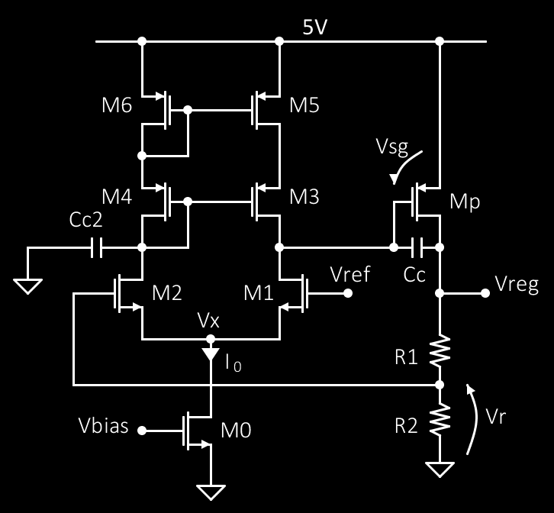

Op-Amp specs
Introduction
Project structure
Original technology
LDO design I
LDO design II
LDO design III
𝐴_{𝑣} > 10000 because for a loop connected amplifier it is important to show a very high gain;
𝑉𝐷𝐷 = 5 𝑉 and 𝑉𝑆𝑆 = 0 𝑉;
𝐶_{𝑐} = 𝐶_{𝑐2} = 5 𝑝𝐹 from the original design: this value has been keep as it is since it should take into account the expected capacitive load which is not reported within the reference article;
𝑉_{𝑖𝑛} 𝑟𝑎𝑛𝑔𝑒 = 1,3 𝑉 since the 𝑉_{𝑟} value has been set to 1.65 V;
𝐺𝐵 = 10 𝑀𝐻𝑧, which is an arbitrary value chosen to achieve a reasonable frequency behaviour.
𝐼₀ = 4 𝜇𝐴 from the current budget requirement: this means that SR will not be a driving parameter in this design having the compensation capacitance and the current already fixed.

Slide 8

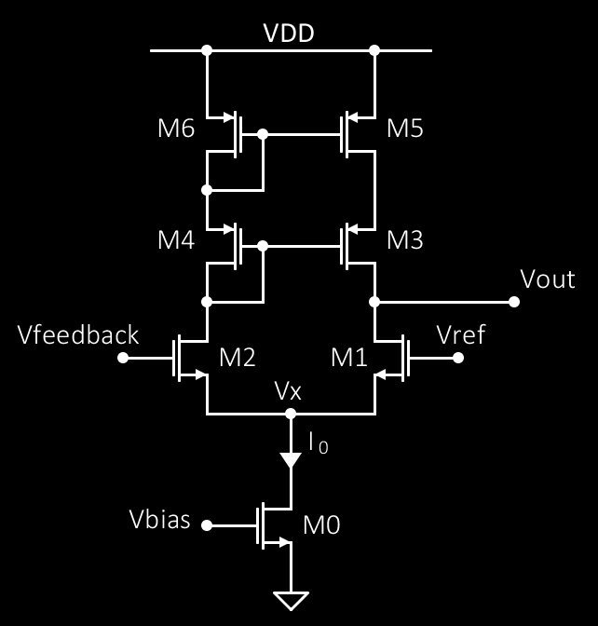

Let’s start from the cascode current mirror dimensioning:
Introduction
Project structure
Original technology
LDO design I
LDO design II
LDO design III
LDO design IV
𝐼₀
|𝐾′ | ∗ (𝑉𝐷𝐷 − 𝐶𝑀𝑅⁺ − 𝑉_{𝑇𝐻} − 𝑉_{𝑇𝐻} + 𝑉_{𝑇𝐻} )²/2
𝑝
4 6
2
substituting the variables it comes out that:
2 ∗ 4 𝜇
≅ 1.35
18.9 𝜇 ∗ (5 − 3 − 0.9 − 0.9 + 0.76)²
Since this is the minimum value to keep the mirror working correctly and it is useful to have a larger margin due to the huge importance of current pairing in a differential stage, the chosen ratio is 2 times the computed one. So that ^{𝑊}Τ_{𝐿}|₄ = 2.7 which leads to :
𝐿₄ = 𝐿₃ = 𝐿₅ = 𝐿₆ = 1.8 𝜇𝑚
𝑊₄ = 𝑊₃ = 𝑊₅ = 𝑊₆ = 4.8 𝜇𝑚
The next step is to check the pole associated to 𝑀₄ to be larger than GB product.

Slide 9

Introduction
Project structure
Original technology
LDO design I
LDO design II
LDO design III
LDO design IV
LDO design V
The next step is to check the pole associated to 𝑀₄ to be larger than GB product.
𝑔
𝑚₄
𝑝 =
4
2 ∗ 𝐶_{𝑔𝑠}
4
Considering a worst case for the drain-source voltage which is to present a
drop equal to half of VDD, it results 𝑔_{𝑚} = 𝛽 ∗ 𝑉_{𝑑𝑠} = 2.17 ∗ 10⁴ Ω⁻¹ .
The gate capacitance can be computed knowing that the poly/active layers
shows about 2.4 𝑓𝐹/𝜇𝑚² leading to 𝐶_{𝑔𝑠} = 2.4
4
𝑓𝐹
∗ 7.2 𝜇𝑚² = 17.28 𝑓𝐹.
𝜇𝑚²
The pole value is thus 𝑝₄ = 6.29 ∗ 10⁹𝐻𝑧 ≫ 10 𝑀𝐻𝑧.
To make things work the differential transistors must have the same 𝑔_{𝑚}
whose value depends on 𝐺𝐵 ∗ 𝐶_{𝑐}:
𝑔_{𝑚} = 10 𝑀𝐻𝑧 ∗ 5 𝑝𝐹 = 5 ∗ 10⁻⁵ Ω⁻¹
_{𝑔𝑚}2
𝐿₁ = 𝐿₂ = 1.8 𝜇𝑚
′
= 5.4 → 6
𝑊₁ = 𝑊₂ = 10.8 𝜇𝑚
2 ∗ 𝐾_{𝑛} ∗ 𝐼₀

Slide 10
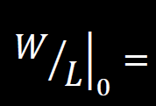
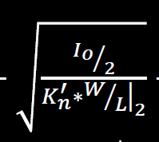
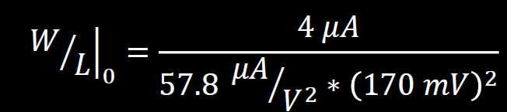
Introduction
Project structure
Original technology
LDO design I
LDO design II
LDO design III
LDO design IV
LDO design V
LDO design VI
The last transistor to be designed is 𝑀 . This step makes use of the CMR-
0
specification to compute the minimum drain-source voltage at which the
transistor must work in saturation region.
𝐼₀
𝐾′ ∗ 𝑉²
𝑛
𝑑𝑠0_{𝑠𝑎𝑡}
+
Being 𝑉_{𝑑𝑠0𝑠𝑎𝑡} = 𝐶𝑀𝑅 − 𝑉𝑆𝑆 −
− 𝑉_{𝑇𝐻2} ≅ 170 𝑚𝑉, the
dimensions ratio of 𝑀₀ must be greater than:
= 2.39 → 3
So:
𝐿₀ = 3.6 𝜇𝑚
𝑊₀ = 10.8 𝜇𝑚
Having all the transistors dimensions set it is possible to compute the output
swing needed for the PMOS pass transistor design.

Slide 11

Introduction
Project structure
Original technology
LDO design I
LDO design II
LDO design III
LDO design IV
LDO design V
LDO design VI
LDO design VII
The lower limit of the output swing sets the maximum gate voltage of
𝑀_{𝑝} and it depends on 𝑀₀ and 𝑀₁ drain-source voltage to keep them
working in saturation.
In general:
^{𝑉}𝑑𝑠
>
^{𝑉}𝑔𝑠 ^{− 𝑉}𝑇𝐻_{𝑛}
𝐼₀ 𝐿
𝑉 = ∗ + 𝑉
𝐼₀ 𝐿
= ∗ = ∆𝑉
𝑔𝑠
_{𝐾}′
𝑊
𝑇𝐻_{𝑛}
→ 𝑉
_{𝐾}′
𝑛
^{𝑑𝑠}𝑚𝑖𝑛
𝑛
𝑊
′
𝐾 = 57.8
𝑛
Since the current 𝐼₀ is 4 𝜇𝐴, it follows that:
𝑉_{𝑜𝑢𝑡𝑚𝑖𝑛} = ∆𝑉₀ + ∆𝑉₁≅ 227 𝑚𝑉
𝑉_{𝑜𝑢𝑡𝑀𝐴𝑋} = 𝑉_{𝐷𝐷} − 2 ∗ ∆𝑉₃ = 4.60 𝑉

Slide 12
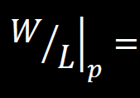

Introduction
Project structure
Original technology
LDO design I
LDO design II
LDO design III
LDO design IV
LDO design V
LDO design VI
LDO design VII
LDO design VIII
this leads to 𝑉_{𝑠𝑔𝑀𝐴𝑋} = 𝑉𝐷𝐷 − 𝑉_{𝑜𝑢𝑡𝑚𝑖𝑛} , which means:
𝑉_{𝑠𝑔𝑀𝐴𝑋} = 5 𝑉 − 227 𝑚𝑉 = 4.77𝑉
But, the saturation condition imposes 𝑉_{𝑠𝑔} > 𝑉_{𝑑𝑠𝑀𝐴𝑋} − 𝑉_{𝑇𝐻𝑝} :
𝑉_{𝑠𝑔𝑠𝑎𝑡} = 𝑉𝐷𝐷 − 𝑉𝑟𝑒𝑔 + 𝑉_{𝑇𝐻𝑝} = 2.6 𝑉 < 4.77 V
The above computed value allows the design of 𝑀_{𝑝} resulting in
the following expression:
^{𝐼𝑑𝑠}𝑀𝐴𝑋
|𝐾′ | ∗ (𝑉_{𝑠𝑔} + |𝑉_{𝑇𝐻} |)²
𝑝
𝑠𝑎𝑡 𝑝
Considering 𝐼_{𝑑𝑠𝑀𝐴𝑋} = 2 𝑚𝐴 the ratio is:
𝐿_{𝑝} = 1.8 𝜇𝑚
→ 40 →
= 36.6
𝑊_{𝑝} = 72 𝜇𝑚

Slide 13
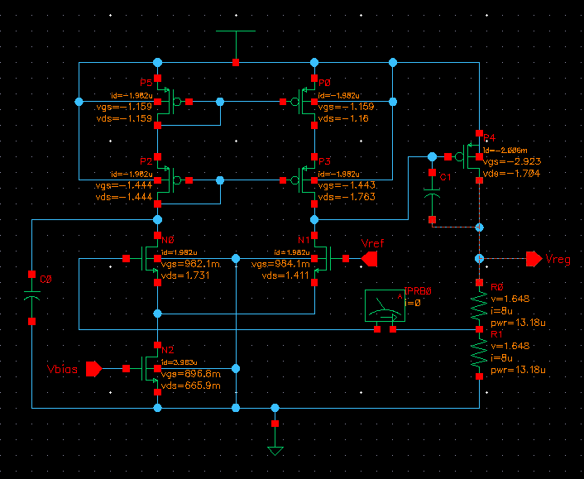
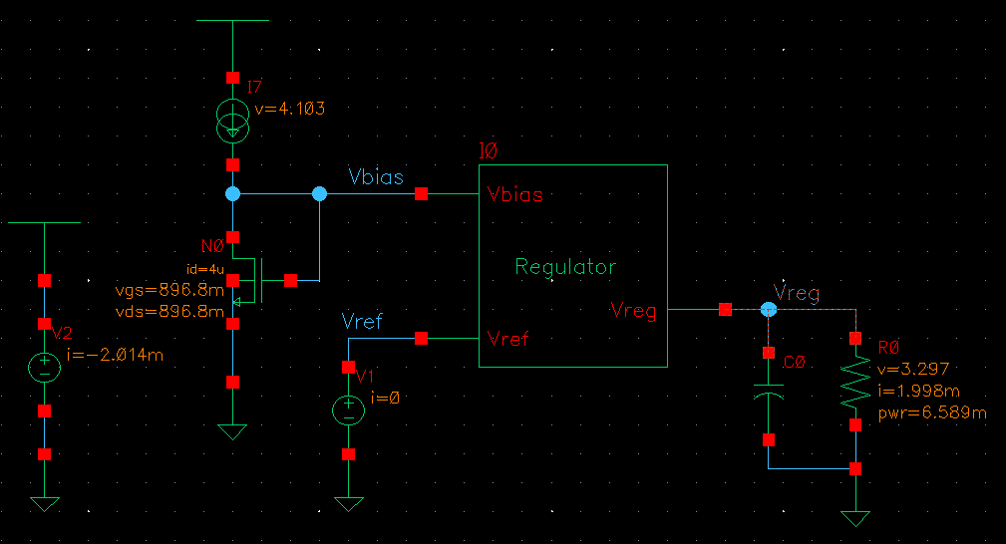
LDO DC Operating Point @ 2mA
Introduction
Project structure
Original technology
LDO design I
LDO design II
LDO design III
LDO design IV
LDO design V
LDO design VI
LDO design VII
LDO design VIII
LDO DC Sim
Here at side is shown the DC operating point of each component within the designed LDO while in the bottom it is reported the simulation environment exploited for the device testing. All transistors are working in saturation region as expected.

Slide 14
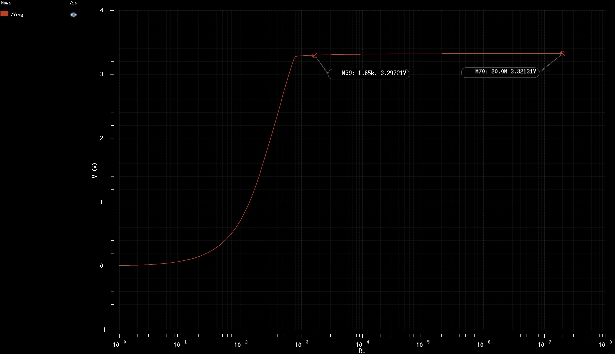
LDO Load regulation
Introduction
Project structure
Original technology
LDO design I
LDO design II
LDO design III
LDO design IV
LDO design V
LDO design VI
LDO design VII
LDO design VIII
LDO DC Sim
LDO Load reg
In figure two markers are shown to highlight the regulated voltage when the load is sinking 2 mA and when its current request is negligible with respect to the LDO resistors branch (@160 nA).
The variation can be computed as percentage ratio:
3.321 − 3.297
∗ 100 ≅ 0.7 %
3.321

Slide 15
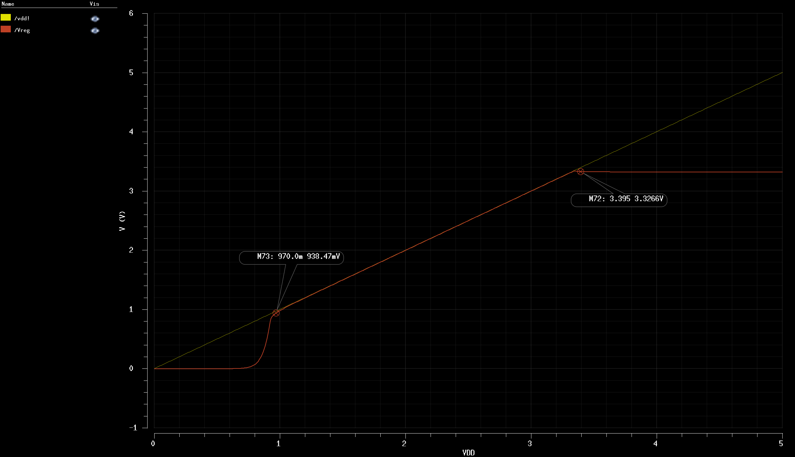
LDO Line regulation
Introduction
Project structure
Original technology
LDO design I
LDO design II
LDO design III
LDO design IV
LDO design V
LDO design VI
LDO design VII
LDO design VIII
LDO DC Sim
LDO Load reg
LDO Line reg
The LDO turns on when VDD approaches 1 V (PMOS pass transistor and works like a resistor until the power supply reaches 3.4 V. From this point on the regulation function starts to be effective.

Slide 16
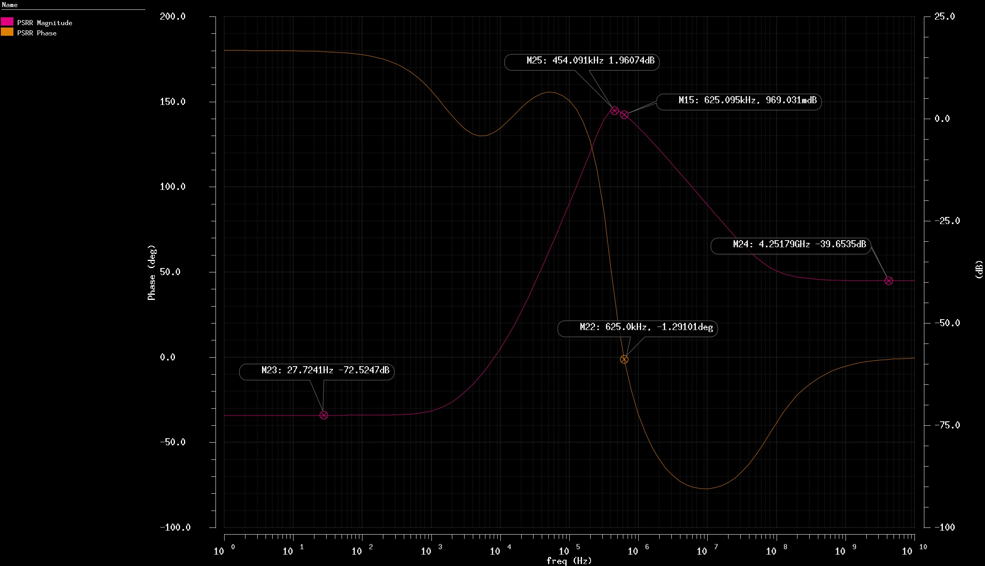
LDO PSRR@23pF capacitive load
Project structure
Original technology
LDO design I
LDO design II
LDO design III
LDO design IV
LDO design V
LDO design VI
LDO design VII
LDO design VIII
LDO DC Sim
LDO Load reg
LDO Line reg
LDO PSRR
The DC PSRR is about -72 dB which is a very good result and the high frequency PSRR is about -40 dB. The central region nonetheless shows a greater than 1 dB gain for power supply noise which represents a problem due to the inverted phase at the same frequency. The performance of the centre region are related to the open-loop gain of the op-amp. So let’s analyse it.

Slide 17
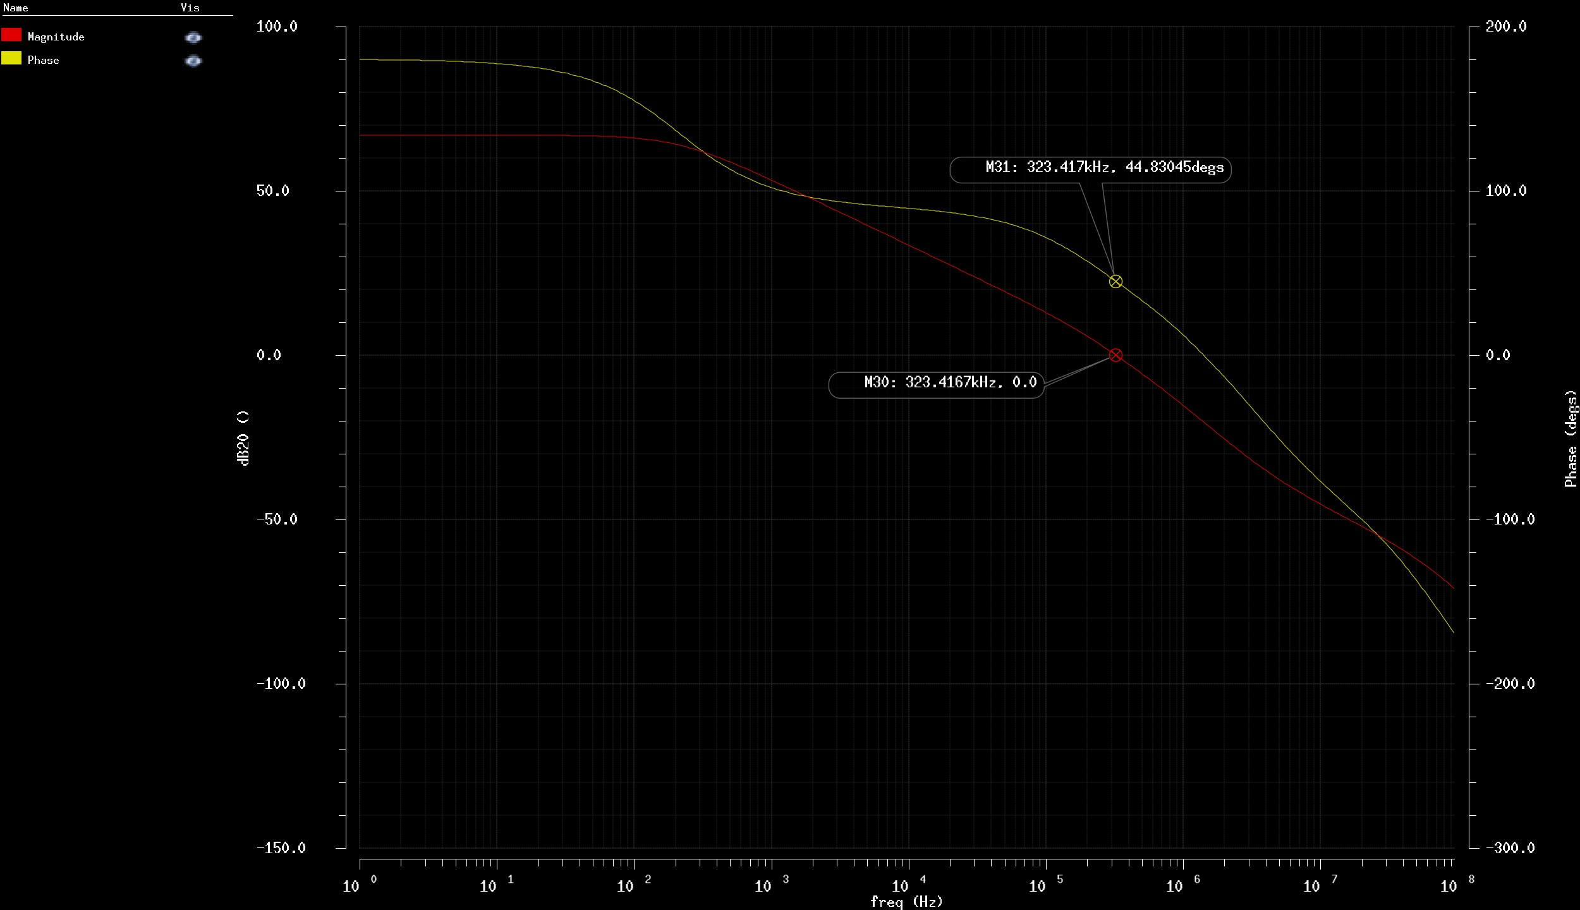
LDO Open-Loop gain
Original technology
LDO design I
LDO design II
LDO design III
LDO design IV
LDO design V
LDO design VI
LDO design VII
LDO design VIII
LDO DC Sim
LDO Load reg
LDO Line reg
LDO PSRR
LDO open-loop
The figure shows a phase margin of about 45° which can be improved by using a bigger compensation capacitance. To this aim a couple of simulations have been performed to find a value which leads to a greater than 60° phase margin.

Slide 18
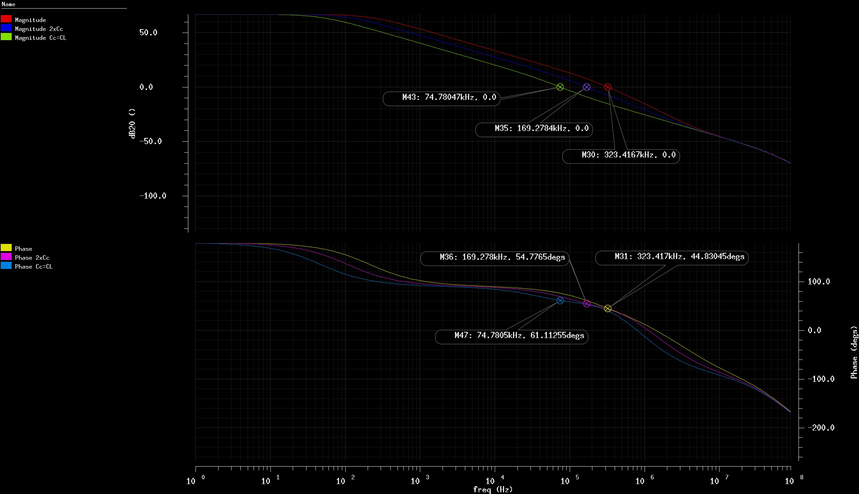
LDO Open-Loop gain analysis vs Cc
LDO design I
LDO design II
LDO design III
LDO design IV
LDO design V
LDO design VI
LDO design VII
LDO design VIII
LDO DC Sim
LDO Load reg
LDO Line reg
LDO PSRR
LDO open-loop
LDO open-loop adj
Starting from Cc = 5 pF the plots show what happens to the open-loop gain when Cc is increased.
Keeping this value it is possible to look at the impact on PSRR. When Cc
= CL = 23 pF the phase margin is greater then 60°.

Slide 19
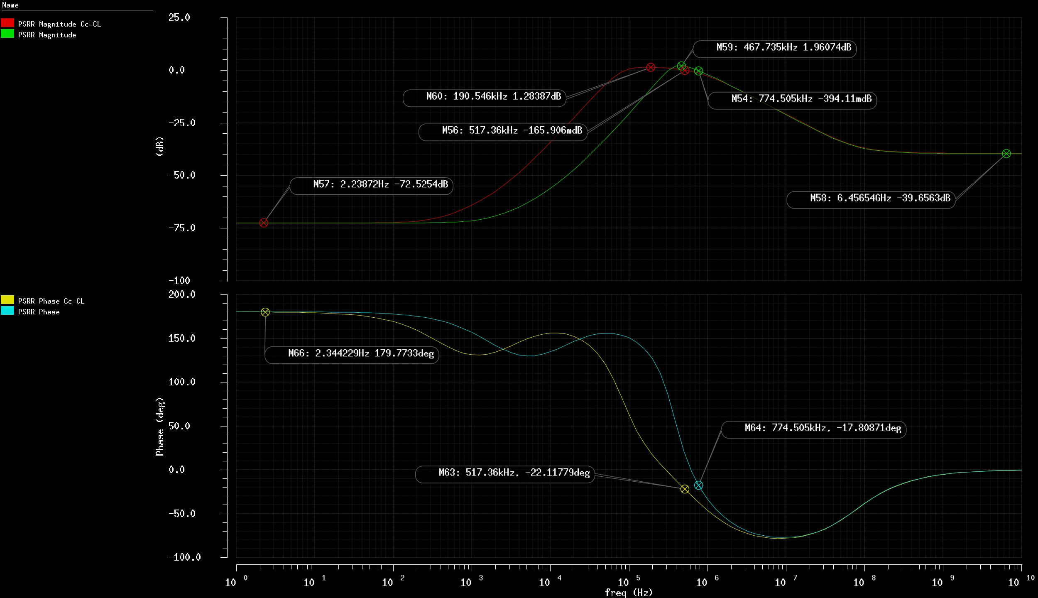
LDO – Open Loop gain impact on PSRR
LDO design II
LDO design III
LDO design IV
LDO design V
LDO design VI
LDO design VII
LDO design VIII
LDO DC Sim
LDO Load reg
LDO Line reg
LDO PSRR
LDO open-loop
LDO open-loop adj
LDO PSRR adj
In this figure can be observed a small reduction of the noise gain peak but the frequency at which it occurs is reduced too. Considering the results, the compensation capacitor has been kept at the original 5 pF value

Slide 20
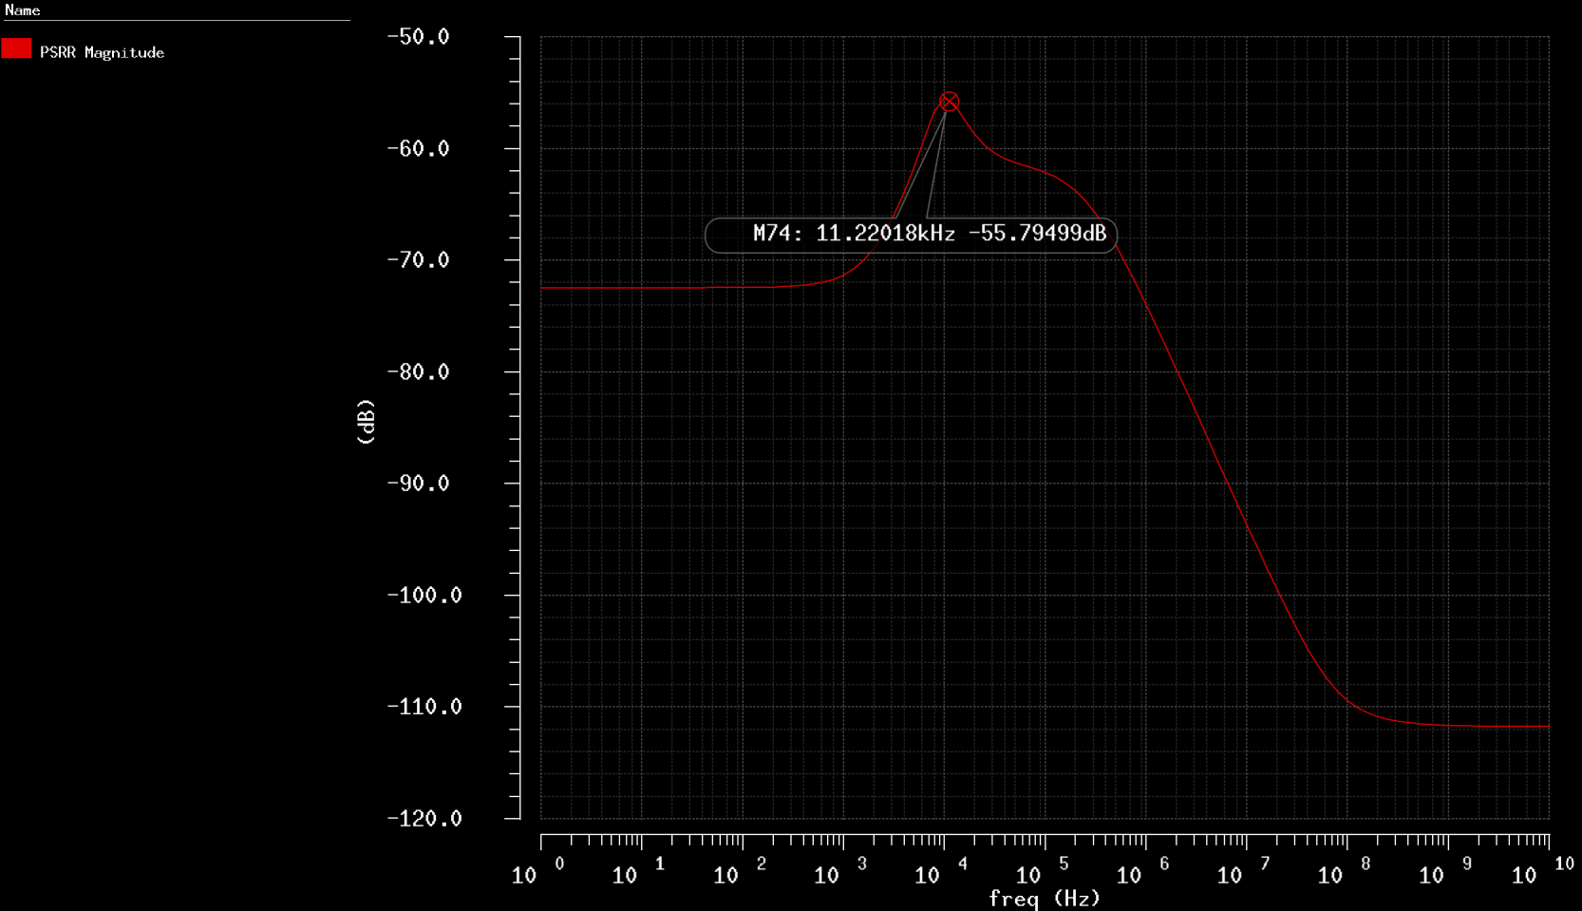
LDO outcomes
LDO design III
LDO design IV
LDO design V
LDO design VI
LDO design VII
LDO design VIII
LDO DC Sim
LDO Load reg
LDO Line reg
LDO PSRR
LDO open-loop
LDO open-loop adj
LDO PSRR adj
LDO outcomes
The final result is an LDO which respects all the project specifications delivering up to 2 mA with a 0.7 % load regulation.
The PSRR is about -70 dB at DC and about -40 dB at high frequency but shows a positive peak around 450 MHz. It is important to remind that these results are mainly due to a missing external capacitance which would stabilise the PSRR behaviour. For example with a 100 nF capacitor the PSRR is almost stable around -70 dB and grows to more than 100 dB at high frequency.
The final performances with a schematic level BIAS circuit and a layout level voltage reference will be evaluated later on.

Slide 21
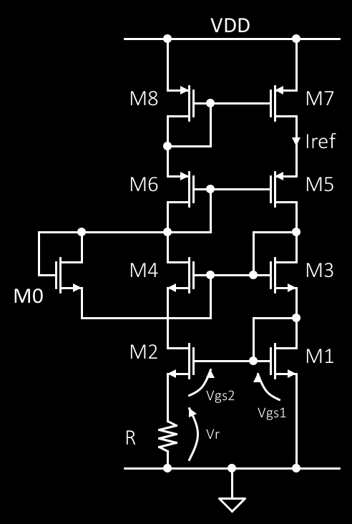
LDO design IV
LDO design V
LDO design VI
LDO design VII
LDO design VIII
LDO DC Sim
LDO Load reg
LDO Line reg
LDO PSRR
LDO open-loop
LDO open-loop adj
LDO PSRR adj
LDO outcomes
BIAS design I
BIAS circuit design
The BIAS circuit design starts from the following equations set:
𝑉_{𝑔𝑠1} = 𝑉_{𝑔𝑠2} + 𝑅 ∗ 𝐼_{𝑟𝑒𝑓} (1)
^{𝑉}𝑔𝑠₁
> 𝑉_{𝑔𝑠2} → 𝛽₂ = 𝑘 ∗ 𝛽₁
2 ∗ 𝐼_{𝑟𝑒𝑓}
𝑉_{𝑔𝑠} =
+ 𝑉_{𝑇𝐻𝑛}
𝛽
Since 𝐼_{𝑟𝑒𝑓} = 4 𝜇𝐴, 𝑉_{𝑇𝐻} = 0.76 𝑉, 𝛽 = 115.6 ^{𝜇𝐴}ൗ ₂ ∗ ^{𝑊}Τ_{𝐿} , some
𝑛
𝑉
other parameter must be fixed to complete the following design equation derived from (1):
2 1
𝑅 =
∗ 1 −
𝛽 ∗ 𝐼
𝑘
1 𝑟𝑒𝑓

Slide 22

LDO design V
LDO design VI
LDO design VII
LDO design VIII
LDO DC Sim
LDO Load reg
LDO Line reg
LDO PSRR
LDO open-loop
LDO open-loop adj
LDO PSRR adj
LDO outcomes
BIAS design I
BIAS design II
To have a better match of the BIAS current between this circuit and the LDO differential amplifier, the dimension ratio of 𝑀₁ can be the same of 𝑀₀ within the LDO which is:
𝐿₁ = 𝐿₃ = 3.6 𝜇𝑚
= 3 →
𝑊₁ = 𝑊₃ = 10.8 𝜇𝑚
Setting the parameter k = 1.1 the resistor value becomes:
2
1
𝐿₂ = 𝐿₄ = 3.6 𝜇𝑚
𝑊₂ = 𝑊₄ = 11.85 𝜇𝑚
𝑅 =
∗ 1 −
= 1.767 𝑘Ω and
346.8𝜇∗4𝜇
1.1
The cascode current mirror transistors can be designed to keep working in saturation when the voltage drop above them is 2 V (arbitrary choice which can be replaced from a 2 ∗ ∆𝑉_{𝑛} + 7𝑚𝑉 minimum drop on 𝑀₂ and 𝑀₄ plus an arbitrary safety voltage or the min VDD allowed) , considering half of the voltage on each transistor:
^{𝑊}ൗ_{𝐿}ቚ = ^{𝑊}ൗ_{𝐿}ቚ = ^{𝑊}ൗ_{𝐿}ቚ = ^{𝑊}ൗ_{𝐿}ቚ =
8 7 6 5
^{𝐼}𝑟𝑒𝑓
≅ 21
_{𝐾}′
∗ 1 − 0.9 ²
𝑝

Slide 23

LDO design VI
LDO design VII
LDO design VIII
LDO DC Sim
LDO Load reg
LDO Line reg
LDO PSRR
LDO open-loop
LDO open-loop adj
LDO PSRR adj
LDO outcomes
BIAS design I
BIAS design II
BIAS design III
Finally, the dimensions can be computed as:
→
𝐿₈ = 𝐿₇ = 𝐿₆ = 𝐿₅ = 1.8 𝜇𝑚
𝑊₈ = 𝑊₇ = 𝑊₆ = 𝑊₅ = 37.8 𝜇𝑚
The last transistor is a diode connected NMOS which acts as a start-up circuit sinking a very small current from the gates of transistors 5 and 6 and injecting that into the gates of 𝑀₃ and 𝑀₄ when the starting condition causes on its drain-source terminals a large voltage drop. The latter becomes smaller and smaller after start-up and the transistor stops affecting the circuit behaviour. In this way the 0 V stable working point is avoided.
The dimensions of this transistor have been taken from the article original design and verified with simulation throughout a transient analysis.
𝐿₀ = 1.5 𝜇𝑚
𝑊₀ = 15 𝜇𝑚
Now the BIAS circuit is ready to be tested and adjusted.

Slide 24
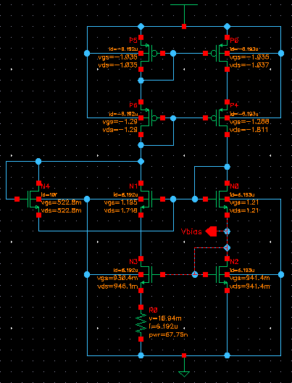
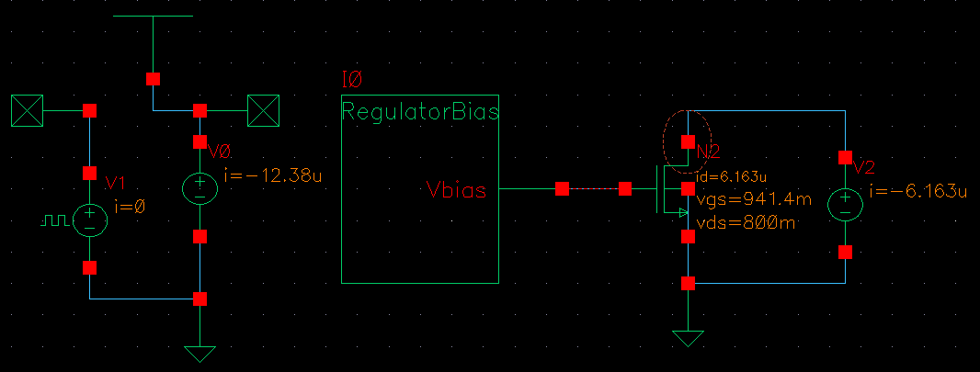
BIAS DC Simulation
LDO design VII
LDO design VIII
LDO DC Sim
LDO Load reg
LDO Line reg
LDO PSRR
LDO open-loop
LDO open-loop adj
LDO PSRR adj
LDO outcomes
BIAS design I
BIAS design II
BIAS design III
BIAS DC sim
The branch current has a value of about 6 𝜇𝐴 which is higher then the target value. To adjust this result it is possible to act on the resistor performing a parameter sweep analysis varying its resistance.

Slide 25
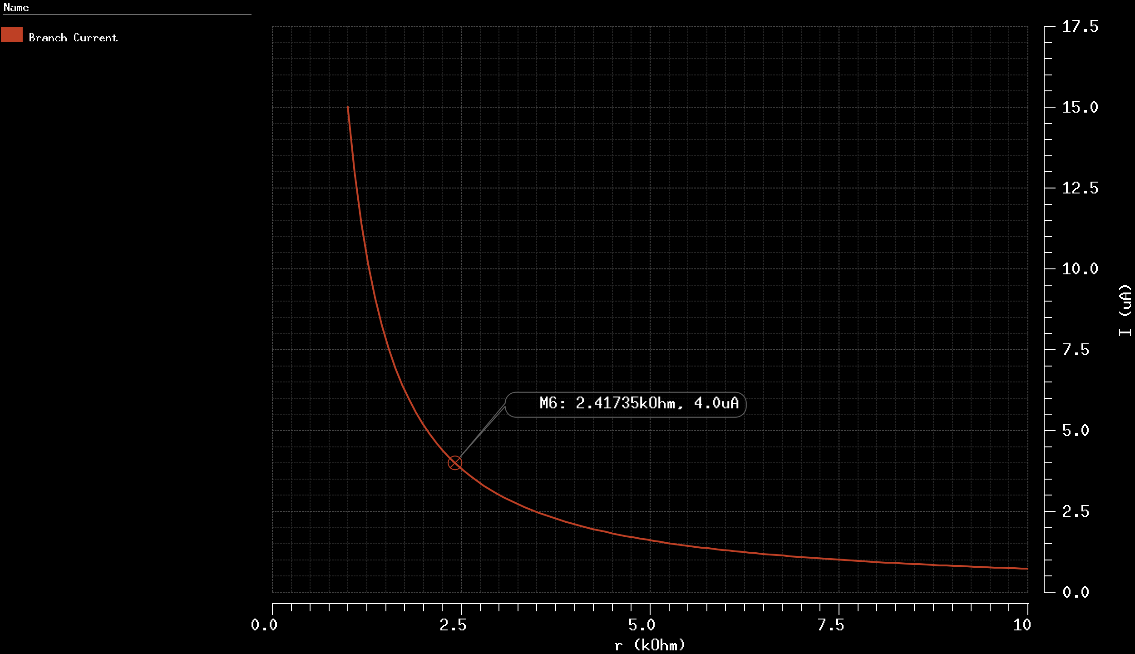
BIAS DC adjust
LDO design VIII
LDO DC Sim
LDO Load reg
LDO Line reg
LDO PSRR
LDO open-loop
LDO open-loop adj
LDO PSRR adj
LDO outcomes
BIAS design I
BIAS design II
BIAS design III
BIAS DC sim
BIAS DC adj I
The marker highlights the resistance value to be implemented in order to have a branch current of about 4 𝜇𝐴 . Then a new DC simulation is performed to verify the correct behaviour of the circuit.
→ R = 2.5 kΩ

Slide 26
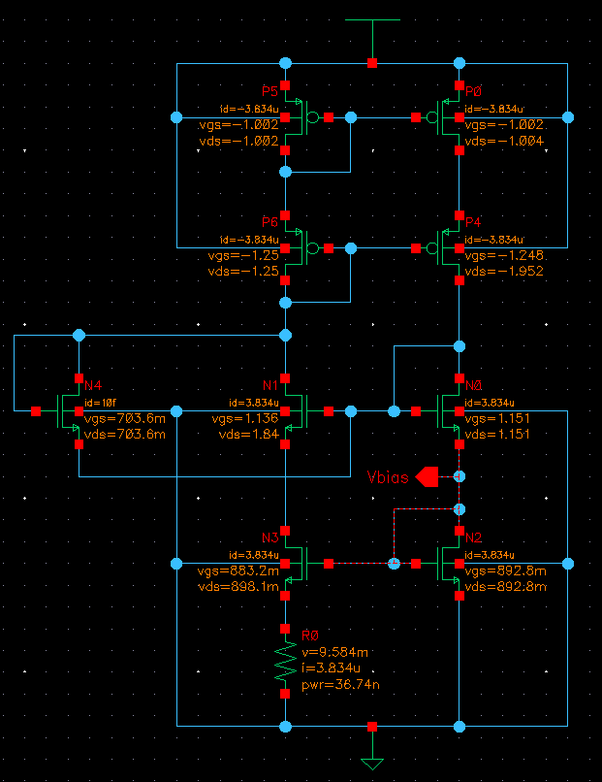
LDO DC Sim
LDO Load reg
LDO Line reg
LDO PSRR
LDO open-loop
LDO open-loop adj
LDO PSRR adj
LDO outcomes
BIAS design I
BIAS design II
BIAS design III
BIAS DC sim
BIAS DC adj I
BIAS DC adj II
The final circuit drives 3.83 𝜇𝐴 in each branch. This result is acceptable and the simulation verifies that all the transistors are working in saturation region and above threshold. The following slides will report a set of simulations to characterize the designed circuit.

Slide 27
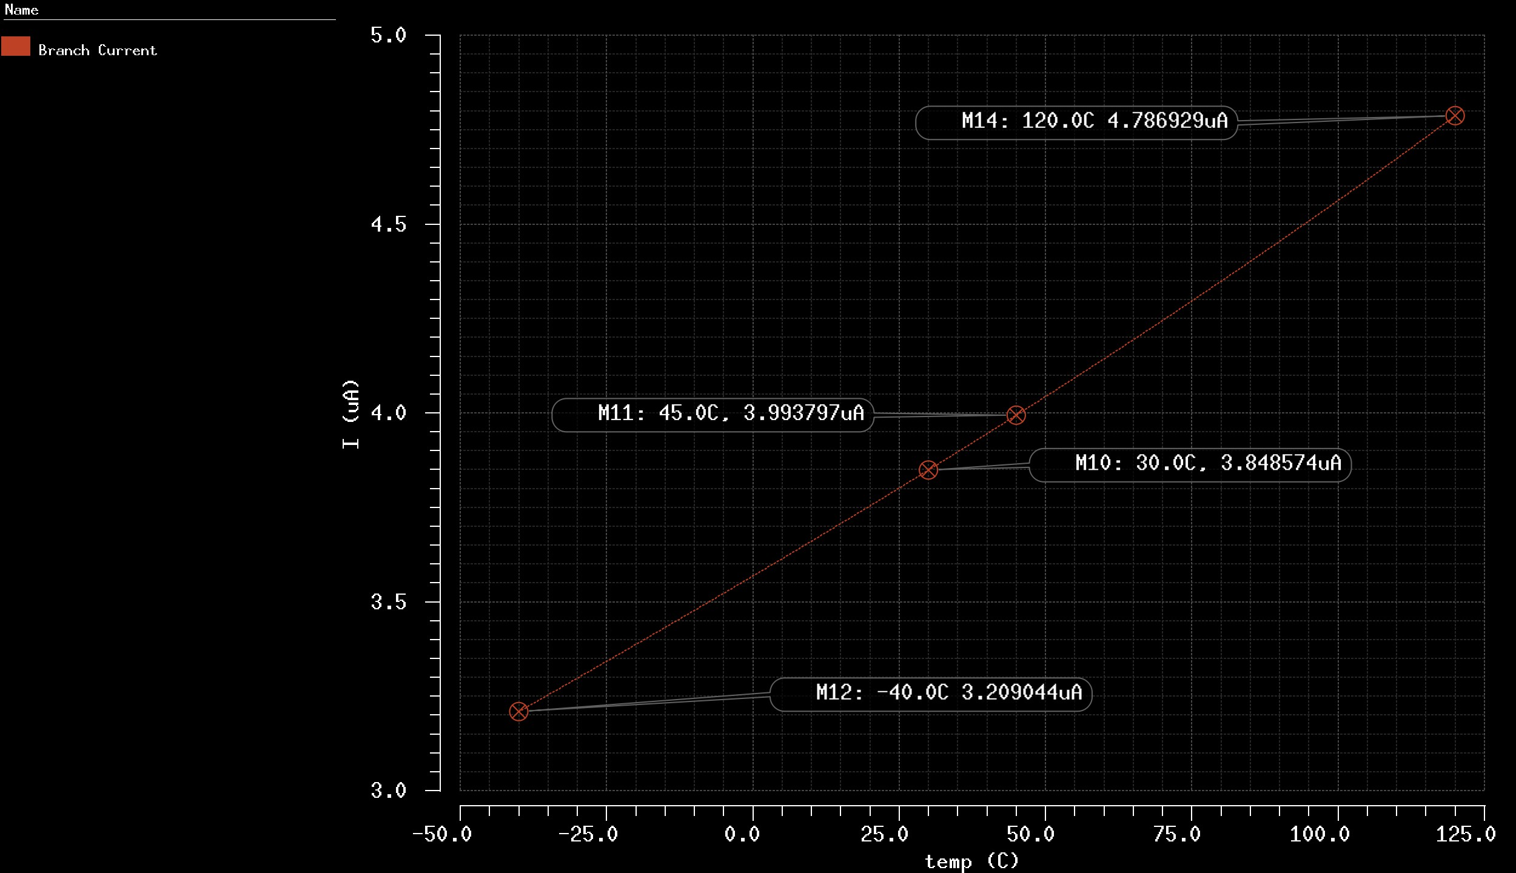
BIAS temperature sweep
LDO Load reg
LDO Line reg
LDO PSRR
LDO open-loop
LDO open-loop adj
LDO PSRR adj
LDO outcomes
BIAS design I
BIAS design II
BIAS design III
BIAS DC sim
BIAS DC adj I
BIAS DC adj II
BIAS temp sweep
The considered range is the one delimited by M10 and M11 which goes from 30°C to 45°C.
The reason for this short range is the target application of the device which is intended to work with human implanted circuitry, meaning that the body temperature is the reference for this project.
The variation of the BIAS current
can be computed as:
3.99 − 3.84
∗ 100 = 3.8 %
3.99

Slide 28
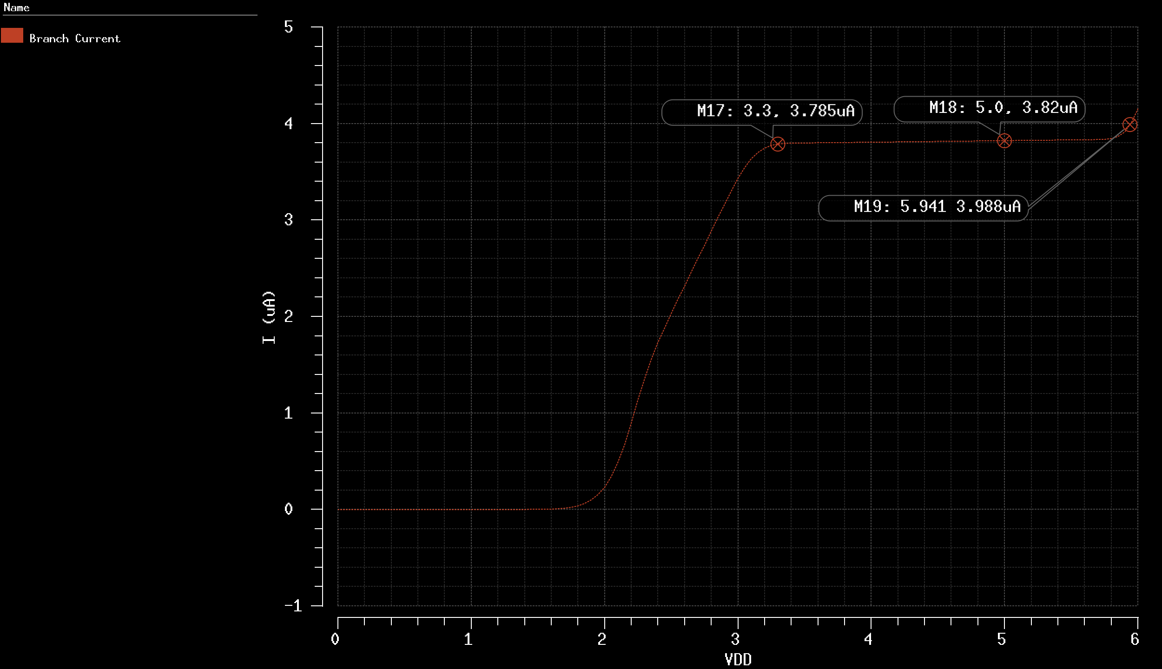
BIAS Line Regulation
LDO Line reg
LDO PSRR
LDO open-loop
LDO open-loop adj
LDO PSRR adj
LDO outcomes
BIAS design I
BIAS design II
BIAS design III
BIAS DC sim
BIAS DC adj I
BIAS DC adj II
BIAS Temp sweep
BIAS Line reg
There is no particular specification about the supply voltage range but the plot shows a stable behaviour between 3.3V and about 5.9V.
To get some quantitative value, the variation of bias current between
3.3V and 5V can be computed:
3.82 − 3.785
∗ 100 ≅ 0.9 %
3.82

Slide 29
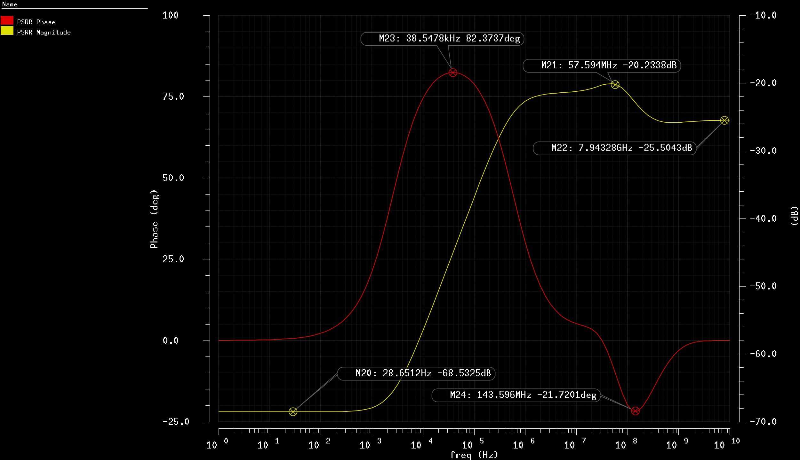
BIAS PSRR
LDO PSRR
LDO open-loop
LDO open-loop adj
LDO PSRR adj
LDO outcomes
BIAS design I
BIAS design II
BIAS design III
BIAS DC sim
BIAS DC adj I
BIAS DC adj II
BIAS Temp sweep
BIAS Line reg
BIAS PSRR
The BIAS circuit presents a good PSRR behaviour:
-68 dB @ DC
-20 dB peak @ 58MHz
-25 dB @ HF

Slide 30
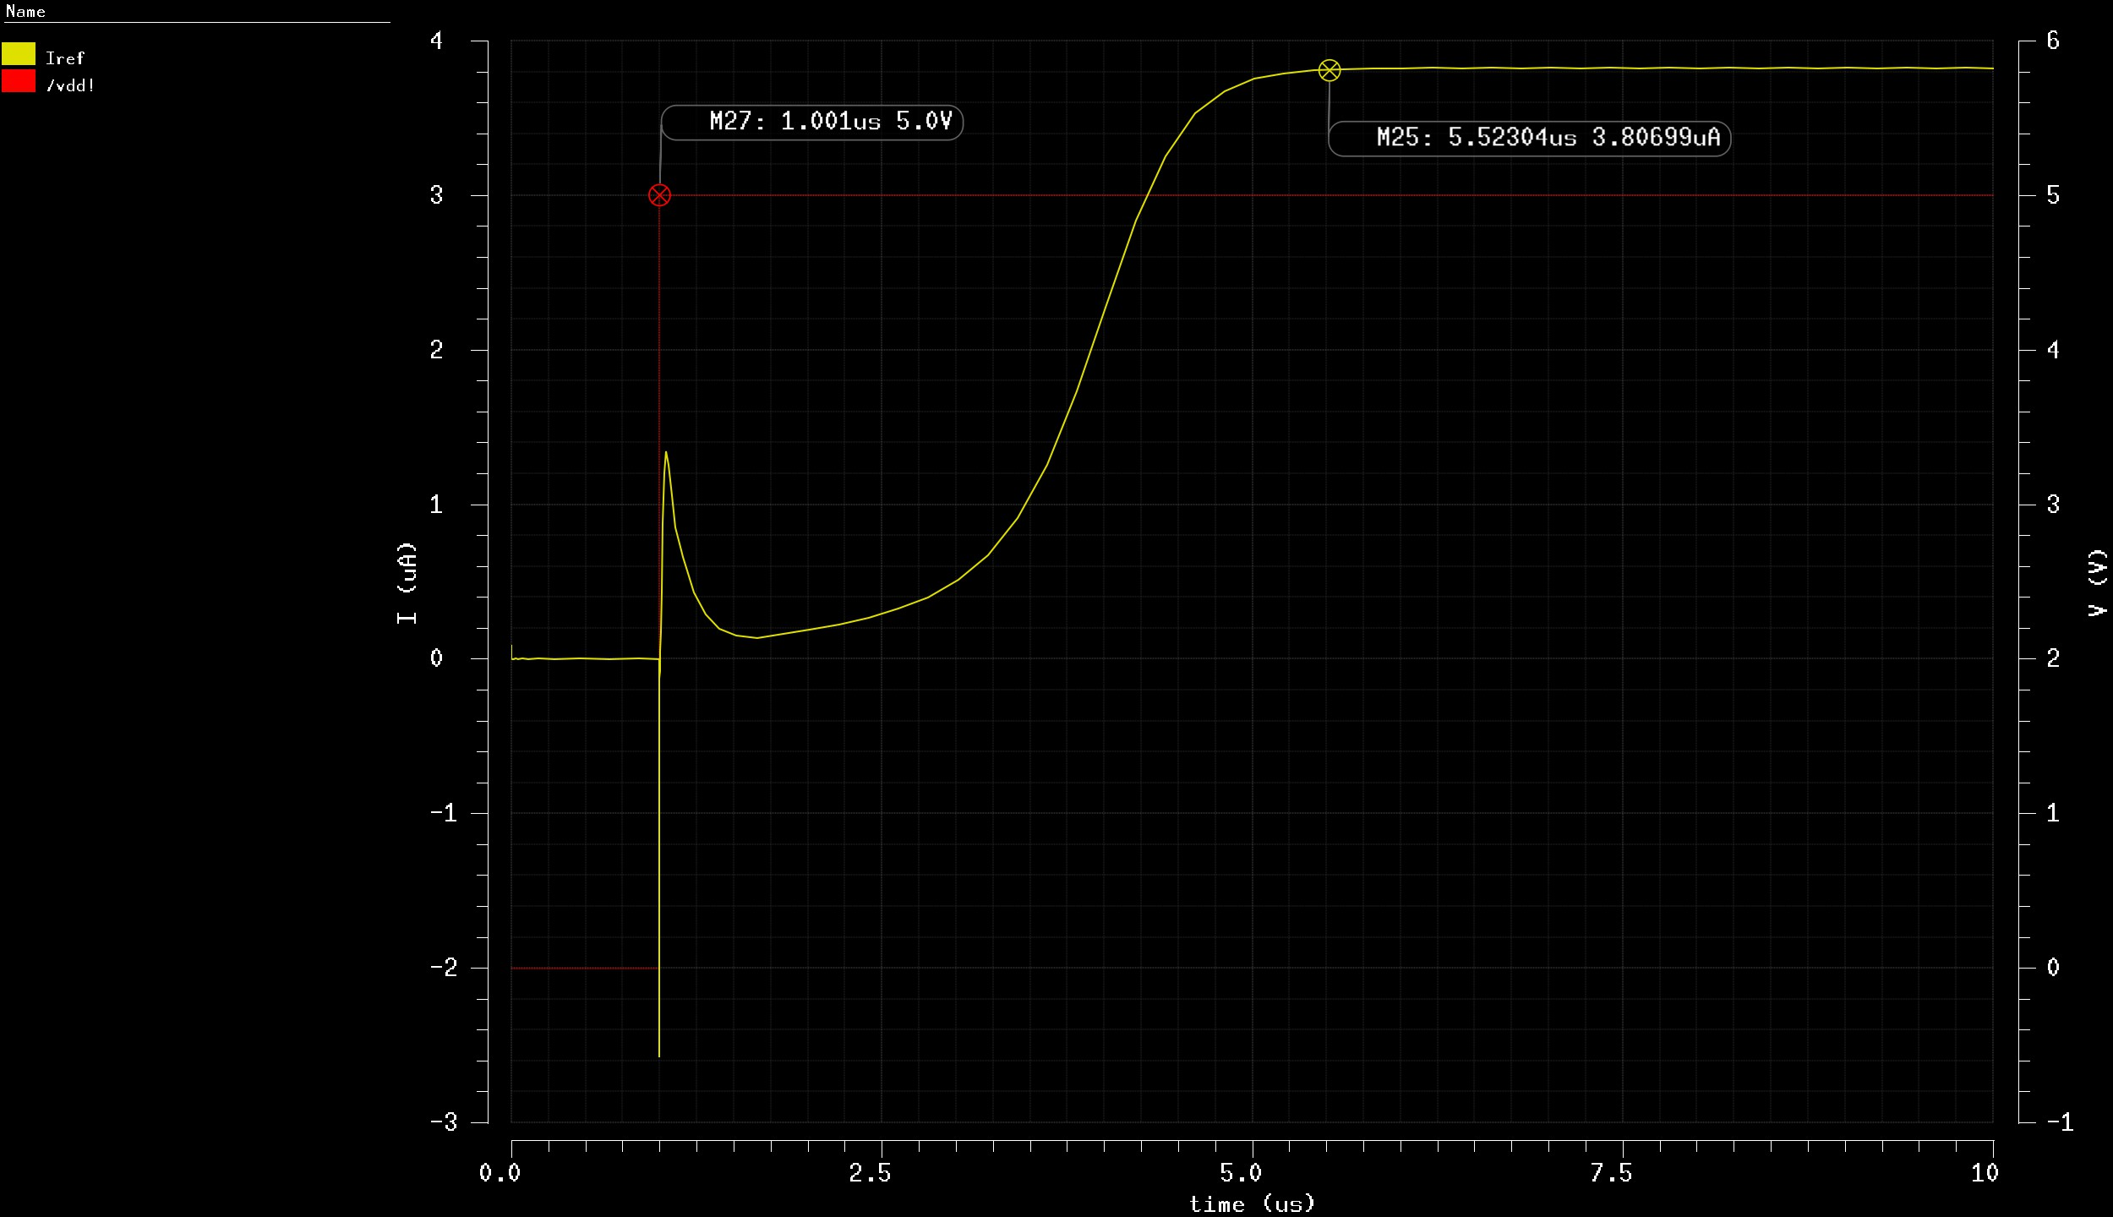
LDO open-loop
LDO open-loop adj
LDO PSRR adj
LDO outcomes
BIAS design I
BIAS design II
BIAS design III
BIAS DC sim
BIAS DC adj I
BIAS DC adj II
BIAS Temp sweep
BIAS Line reg
BIAS PSRR
BIAS transient I
The start-up time is about
4.5 𝜇𝑠 and the transient presents a first negative peak followed by an opposite one when VDD steps up. It can be observed in detail in the next slide…

Slide 31
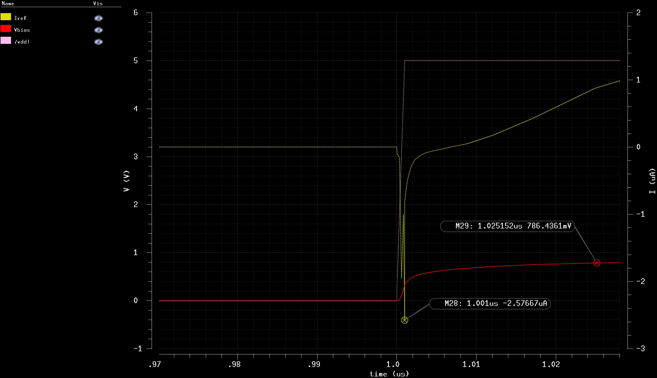
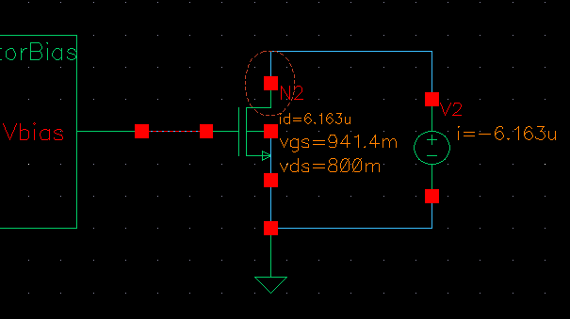
LDO open-loop adj
LDO PSRR adj
LDO outcomes
BIAS design I
BIAS design II
BIAS design III
BIAS DC sim
BIAS DC adj I
BIAS DC adj II
BIAS Temp sweep
BIAS Line reg
BIAS PSRR
BIAS transient I
BIAS transient II
In this plot the overlapping of the VDD step and the inverse current peak is highlighted. It could be caused by the fixed voltage imposed at the drain-source terminals of the copied transistor.

Slide 32
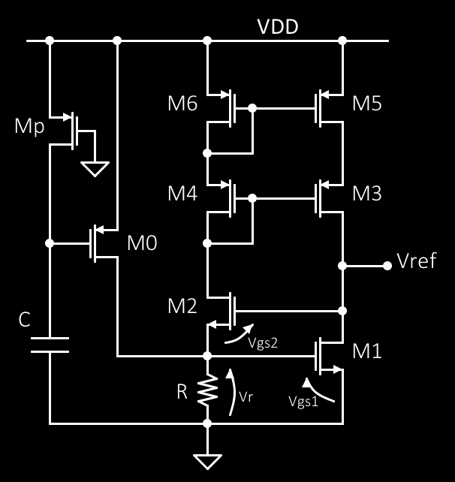

Voltage reference design
LDO PSRR adj
LDO outcomes
BIAS design I
BIAS design II
BIAS design III
BIAS DC sim
BIAS DC adj I
BIAS DC adj II
BIAS Temp sweep
BIAS Line reg
BIAS PSRR
BIAS transient I
BIAS transient II
Reference design I
The last block to be designed is the voltage reference to be connected to the non-inverting pin of the LDO differential amplifier. Here will be listed the set of design equation and the assumption needed to get the final circuit.
The driving parameter are the target 𝑉_{𝑟𝑒𝑓} = 1.65 𝑉 and the current budget assigned at the beginning of the project which is 8 𝜇𝐴. The latter sets the branch current to be 4 𝜇𝐴.
The last degree of freedom is about the voltage drop above R. It must be, of course, above threshold and in this case it will be 𝑉_{𝑟} = 0.81 𝑉. Since 𝑉_{𝑟} = 𝑉_{𝑔𝑠1} :
^{𝐼}𝑏𝑟𝑎𝑛𝑐ℎ
4 𝜇
=
= 27.68
𝐾′ ∗ 𝑉_{𝑟} − 𝑉_{𝑇𝐻}
𝑛
2
57.8 𝜇 ∗ 0.81 − 0.76
2
𝑛
Since this circuit will be implemented at layout level too, its design will consider the multiplier of each transistor to.
𝑊₁ = 49.8 𝜇𝑚 𝑊₁ = 8 ∗ 6.15 𝜇𝑚
→
𝐿₁ = 1.8 𝜇𝑚 𝐿₁ = 1.8 𝜇𝑚

Slide 33

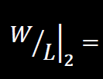
LDO outcomes
BIAS design I
BIAS design II
BIAS design III
BIAS DC sim
BIAS DC adj I
BIAS DC adj II
BIAS Temp sweep
BIAS Line reg
BIAS PSRR
BIAS transient I
BIAS transient II
Reference design I
Reference design II
The resistor value can be computed by means of the simple Ohm’s law:
Due to better layout implementation, this value will be split into 3 parts having a
66.6 𝑘Ω resistance.
The next step is about the transistor 𝑀₂ dimensions. The gate-source voltage of
this device depends on the target 𝑉_{𝑟𝑒𝑓} being 𝑉_{𝑔𝑠2} = 𝑉_{𝑟𝑒𝑓} − 𝑉_{𝑟} = 0.84 𝑉, then:
^{𝐼}𝑏𝑟𝑎𝑛𝑐ℎ
4 𝜇
=
≅ 11
𝐾′ ∗
2
57.8 𝜇 ∗ 0.84 − 0.76
2
𝑛 ^{𝑉}𝑔𝑠₂ ^{− 𝑉}𝑇𝐻_{𝑛}
𝑊₂ = 19.8 𝜇𝑚
𝑊₂ = 8 ∗ 2.5 𝜇𝑚
→
𝐿₂ = 1.8 𝜇𝑚 𝐿₂ = 1.8 𝜇𝑚
Unfortunately, this transistor is strongly affected by body effect which will undermine the validity of the above computed value. For this reason parametric simulation of the width has been performed to adjust the final output voltage value.

Slide 34
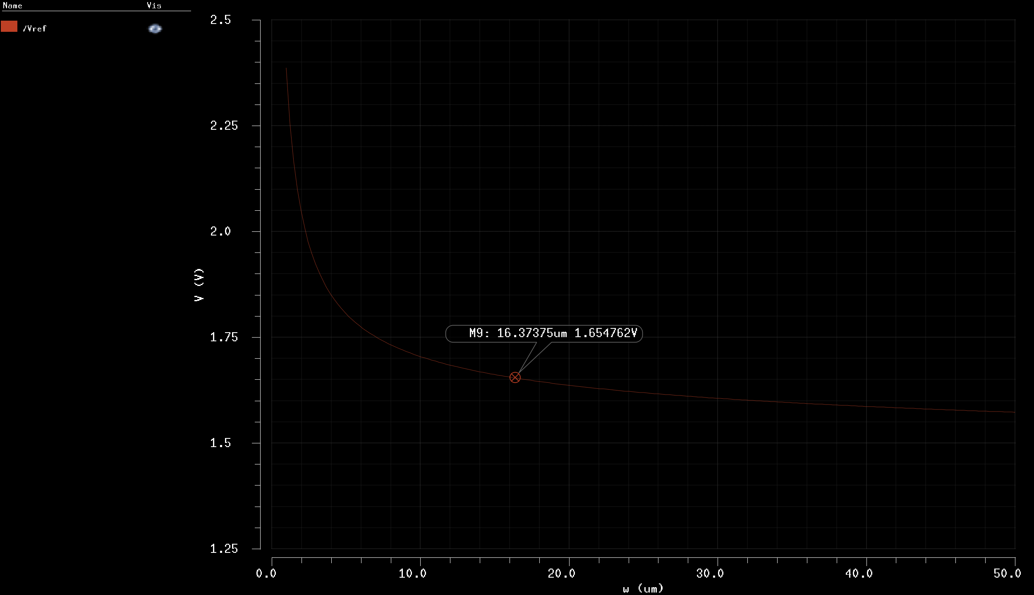
LDO outcomes
BIAS design I
BIAS design II
BIAS design III
BIAS DC sim
BIAS DC adj I
BIAS DC adj II
BIAS Temp sweep
BIAS Line reg
BIAS PSRR
BIAS transient I
BIAS transient II
Reference design I
Reference design II
The output approaches the desired value when 𝑀₂ fingers dimension is around 16 𝜇𝑚, the final dimensions are:
𝑊₂ = 8 ∗ 16.05 𝜇𝑚
𝐿₂ = 1.8 𝜇𝑚
The resulting width is very much larger than the computed one but this was expected due to the strong BULK effect on the transistor.

Slide 35

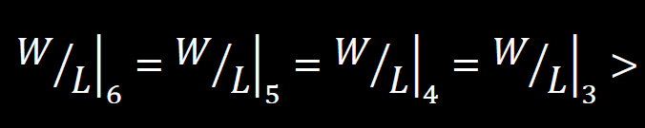
BIAS design I
BIAS design II
BIAS design III
BIAS DC sim
BIAS DC adj I
BIAS DC adj II
BIAS Temp sweep
BIAS Line reg
BIAS PSRR
BIAS transient I
BIAS transient II
Reference design I
Reference design II
Reference design III
The current mirrors and the start-up circuit must be defined. On the left side the minimum voltage for saturation working is:
^{𝐼}𝑏𝑟𝑎𝑛𝑐ℎ
𝑉𝐷𝐷 − 𝑉_{𝑟} − = 4.11 𝑉 @𝑉𝐷𝐷 = 5 𝑉
𝐾′ ∗
𝑛
On the right side the voltage drop above the cascode current mirror is:
𝑉𝐷𝐷 − 𝑉_{𝑟𝑒𝑓} = 3.35 𝑉 @𝑉𝐷𝐷 = 5 𝑉
The second one has been taken as reference being more restrictive. Then,
assuming to have half drop above each transistor:
^{𝐼}𝑏𝑟𝑎𝑛𝑐ℎ
≅ 0.08
3.35
2
𝐾′ ∗
𝑝
2
Since this is a MINIMUM value, the actual dimension has been chosen in order to have almost-square transistor when their width is divided by 4 to implement a cascode 2D structure:
𝑊₆ = 𝑊₅ = 𝑊₄ = 𝑊₃ = 7.2 𝜇𝑚
𝑊₆ = 𝑊₅ = 𝑊₄ = 𝑊₃ = 4 ∗ 1.8 𝜇𝑚
𝐿₆ = 𝐿₅ = 𝐿₄ = 𝐿₃ = 1.8 𝜇𝑚
𝐿₆ = 𝐿₅ = 𝐿₄ = 𝐿₃ = 1.8 𝜇𝑚
→

Slide 36
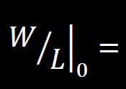
BIAS design I
BIAS design II
BIAS design III
BIAS DC sim
BIAS DC adj I
BIAS DC adj II
BIAS Temp sweep
BIAS Line reg
BIAS PSRR
BIAS transient I
BIAS transient II
Reference design I
Reference design II
Reference design III
The start-up circuit has been borrowed from the original article design being the
chosen topology very simple. The capacitor C is 100 𝑓𝐹 and the transistor 𝑀 is
𝑝
a long resistive device which charges the capacitor until the transistor 𝑀₀ is shut down.
𝐿_{𝑝} = 50 𝜇𝑚
𝑊_{𝑝} = 1.8 𝜇𝑚
The 𝑀₀ dimension has been chosen in order to make it able to keep the VDD voltage on the resistor node until the capacitor reaches ¾ of the power supply voltage. This condition requires the transistor to deliver 25 𝜇𝐴 to the resistor which sees a 5 V drop at its terminals. It results:
25 𝜇
≅ 10
18.9 𝜇 ∗
1.25 − 0.9
2
𝐿₀ = 1.8 𝜇𝑚
𝐿₀ = 1.8 𝜇𝑚
𝑊₀ = 4 ∗ 4.5 𝜇𝑚
𝑊₀ = 18 𝜇𝑚
→
The above specification will be verified by means of a transient simulation.

Slide 37
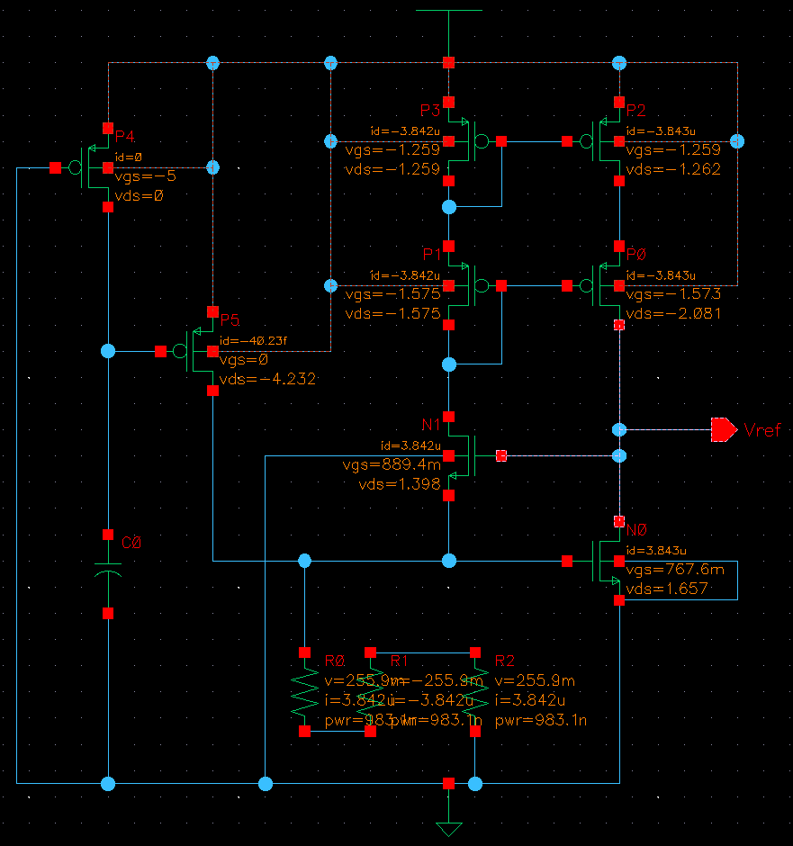
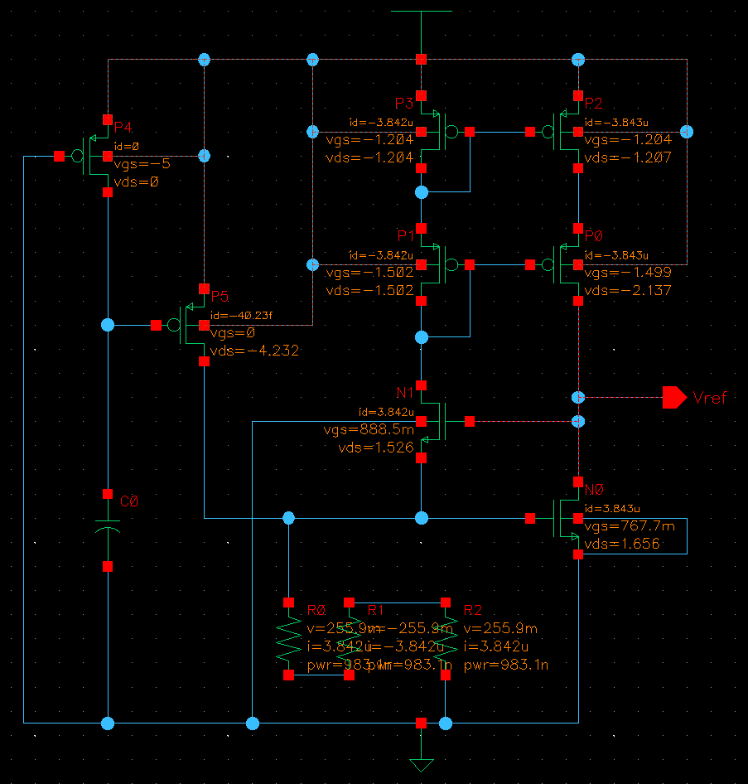
Voltage reference DC simulation
BIAS design II
BIAS design III
BIAS DC sim
BIAS DC adj I
BIAS DC adj II
BIAS Temp sweep
BIAS Line reg
BIAS PSRR
BIAS transient I
BIAS transient II
Reference design I
Reference design II
Reference design III
Reference DC Sim I
The only difference between these two circuits is the multiplier of the cascode current mirror.
All the transistors are saturated and the 𝑉_{𝑔𝑠} of the common centroid version is about 5% higher then the counterpart. This could be seen as a smaller width equivalent transistor driving the same current.
2D common centroid current mirror
2 part split current mirror transistors

Slide 38
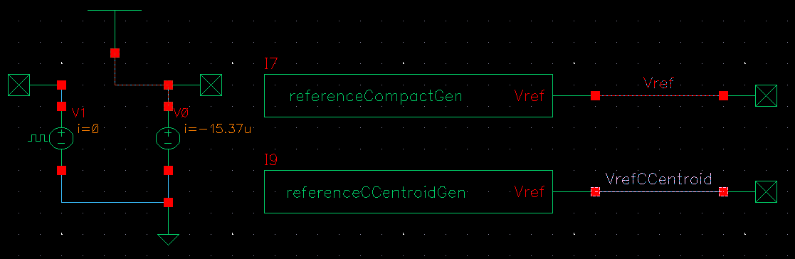
Voltage reference DC simulation environment
BIAS design III
BIAS DC sim
BIAS DC adj I
BIAS DC adj II
BIAS Temp sweep
BIAS Line reg
BIAS PSRR
BIAS transient I
BIAS transient II
Reference design I
Reference design II
Reference design III
Reference DC Sim I
Reference DC Sim II
Both the implementations of the voltage reference generator have been placed into the same schematic in order to perform comparative simulations. The same will be done for the two layout produced in this work.
From now on these two version will be referred as Classic and Centroid as the image below shows.
Classic
Centroid

Slide 39
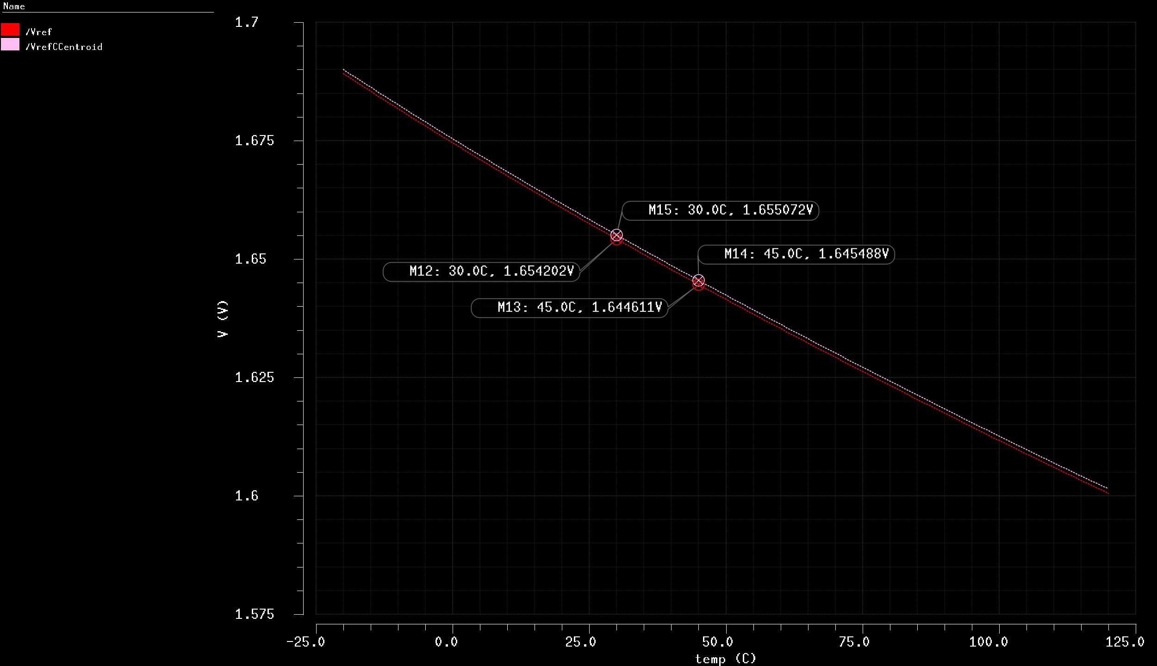
Voltage reference temperature sweep
BIAS DC sim
BIAS DC adj I
BIAS DC adj II
BIAS Temp sweep
BIAS Line reg
BIAS PSRR
BIAS transient I
BIAS transient II
Reference design I
Reference design II
Reference design III
Reference DC Sim I
Reference DC Sim II
Reference T Sweep
The classic version always presents a lower output due to the source-gate voltage difference previously seen by means of DC operation point. As for the BIAS circuit, the range between 30°C and 45°C has been highlighted. Even presenting a little offset the variation is similar and can be computed as:
1.655 − 1.645
∗ 100 ≅ 0.6%
1.655

Slide 40
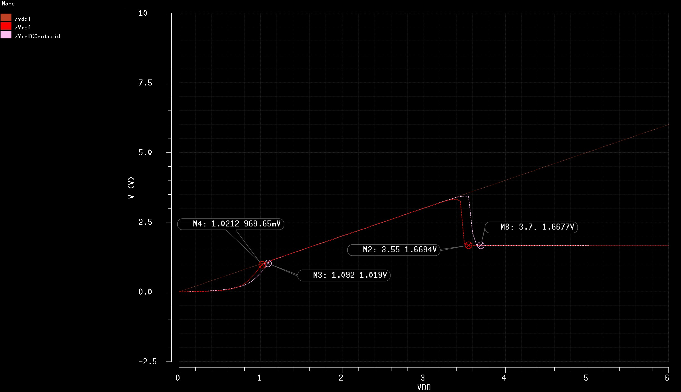
Voltage reference Line regulation
BIAS DC adj I
BIAS DC adj II
BIAS Temp sweep
BIAS Line reg
BIAS PSRR
BIAS transient I
BIAS transient II
Reference design I
Reference design II
Reference design III
Reference DC Sim I
Reference DC Sim II
Reference T Sweep
Reference Line Reg
Over the course of VDD growth the 𝑉_{𝑟𝑒𝑓} value follows the transistors power-on and the upper PMOS devices connect 𝑉_{𝑟𝑒𝑓} to VDD until the voltage is enough to bring the NMOS transistors into the saturation region. Then the output voltage is pulled down and it settles at the design value.

Slide 41
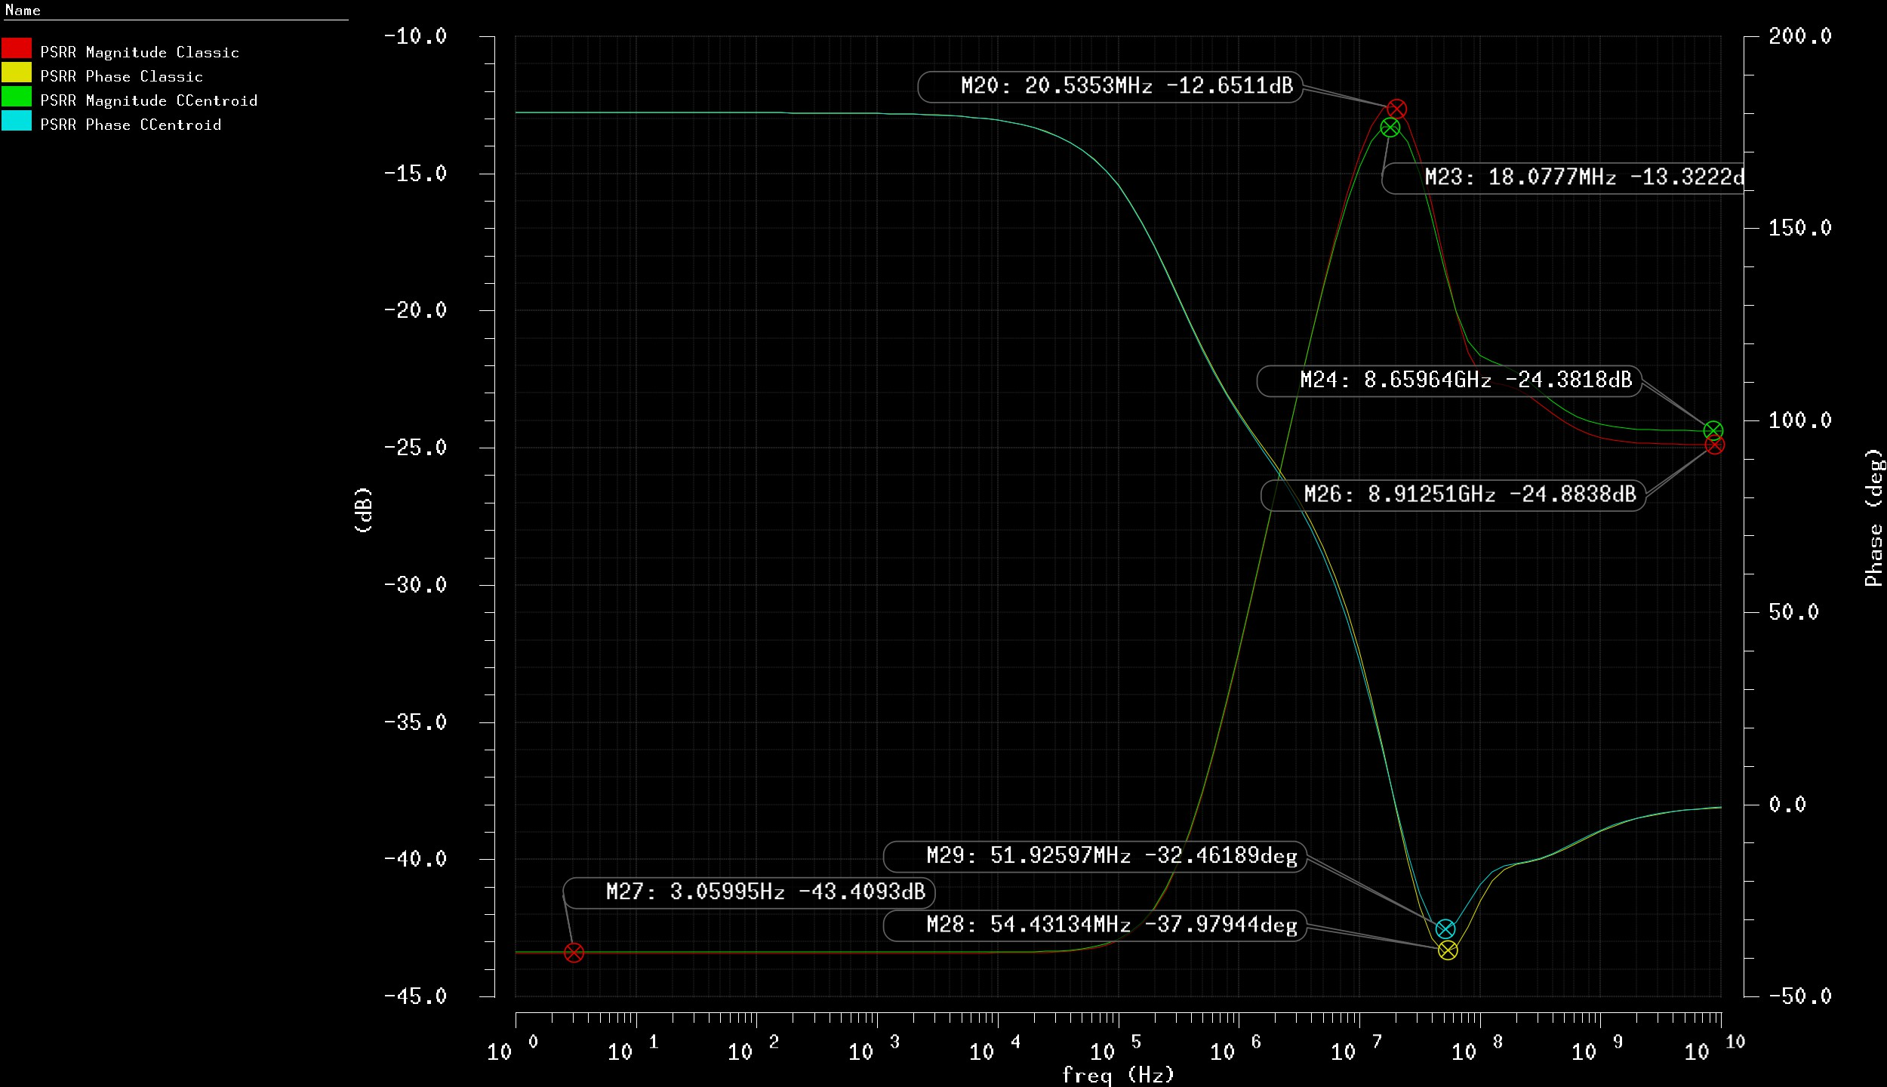
Voltage reference PSRR analysis
BIAS DC adj II
BIAS Temp sweep
BIAS Line reg
BIAS PSRR
BIAS transient I
BIAS transient II
Reference design I
Reference design II
Reference design III
Reference DC Sim I
Reference DC Sim II
Reference T Sweep
Reference Line Reg
Reference PSRR
All the points of interest are
highlighted. The PSRR is about
-13 dB when the frequency is around 20 MHz and falls down to -24 dB at higher frequency.
The DC PSRR is -43 dB and the Centroid circuit shows a 5% increment of peak PSRR performances.

Slide 42
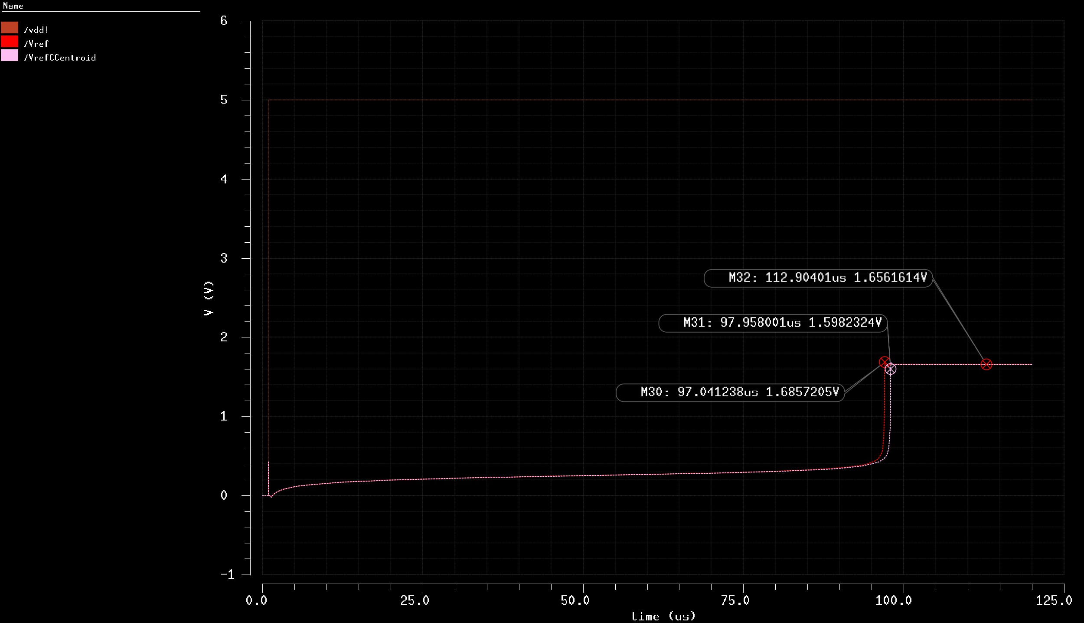
Voltage reference transient analysis
BIAS Temp sweep
BIAS Line reg
BIAS PSRR
BIAS transient I
BIAS transient II
Reference design I
Reference design II
Reference design III
Reference DC Sim I
Reference DC Sim II
Reference T Sweep
Reference Line Reg
Reference PSRR
Reference Tran I
The transient analysis is performed applying a step signal to VDD with a 1 𝜇𝑠 delay. In the right plot are shown the start-up time of both the circuits:
Classic: ≈ 97 𝜇𝑠
Centroid: ≈ 98 𝜇𝑠
Both of them reaches the same reference voltage of 1.656 V.

Slide 43
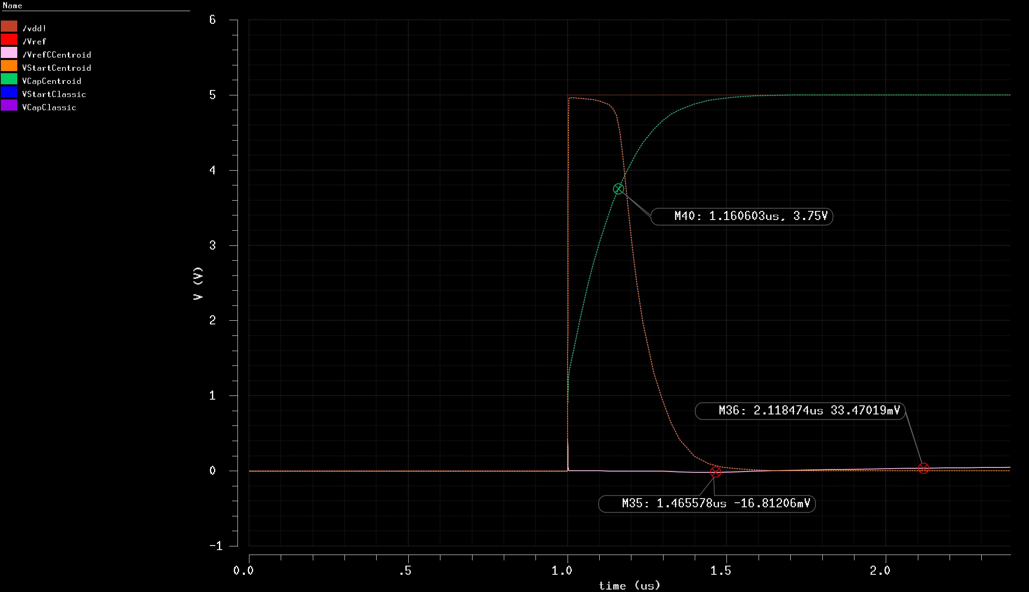
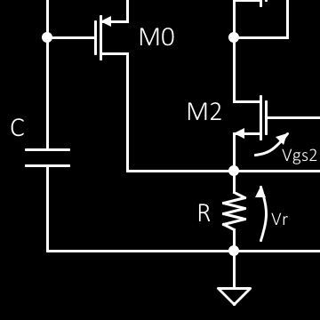
BIAS Line reg
BIAS PSRR
BIAS transient I
BIAS transient II
Reference design I
Reference design II
Reference design III
Reference DC Sim I
Reference DC Sim II
Reference T Sweep
Reference Line Reg
Reference PSRR
Reference Tran I
Reference Tran II
As designed, the start-up transistor (𝑀₀) keeps the high voltage on the R node until the capacitor voltage (green line) reaches ¾ of VDD.
Then the voltage across R drops down but in the meantime the current starts to flow into the circuit and the 0 V stability point is abandoned.
Indeed, the 𝑉_{𝑟𝑒𝑓} voltage starts
growing as the markers M35
and M36 show.
VStart

Slide 44
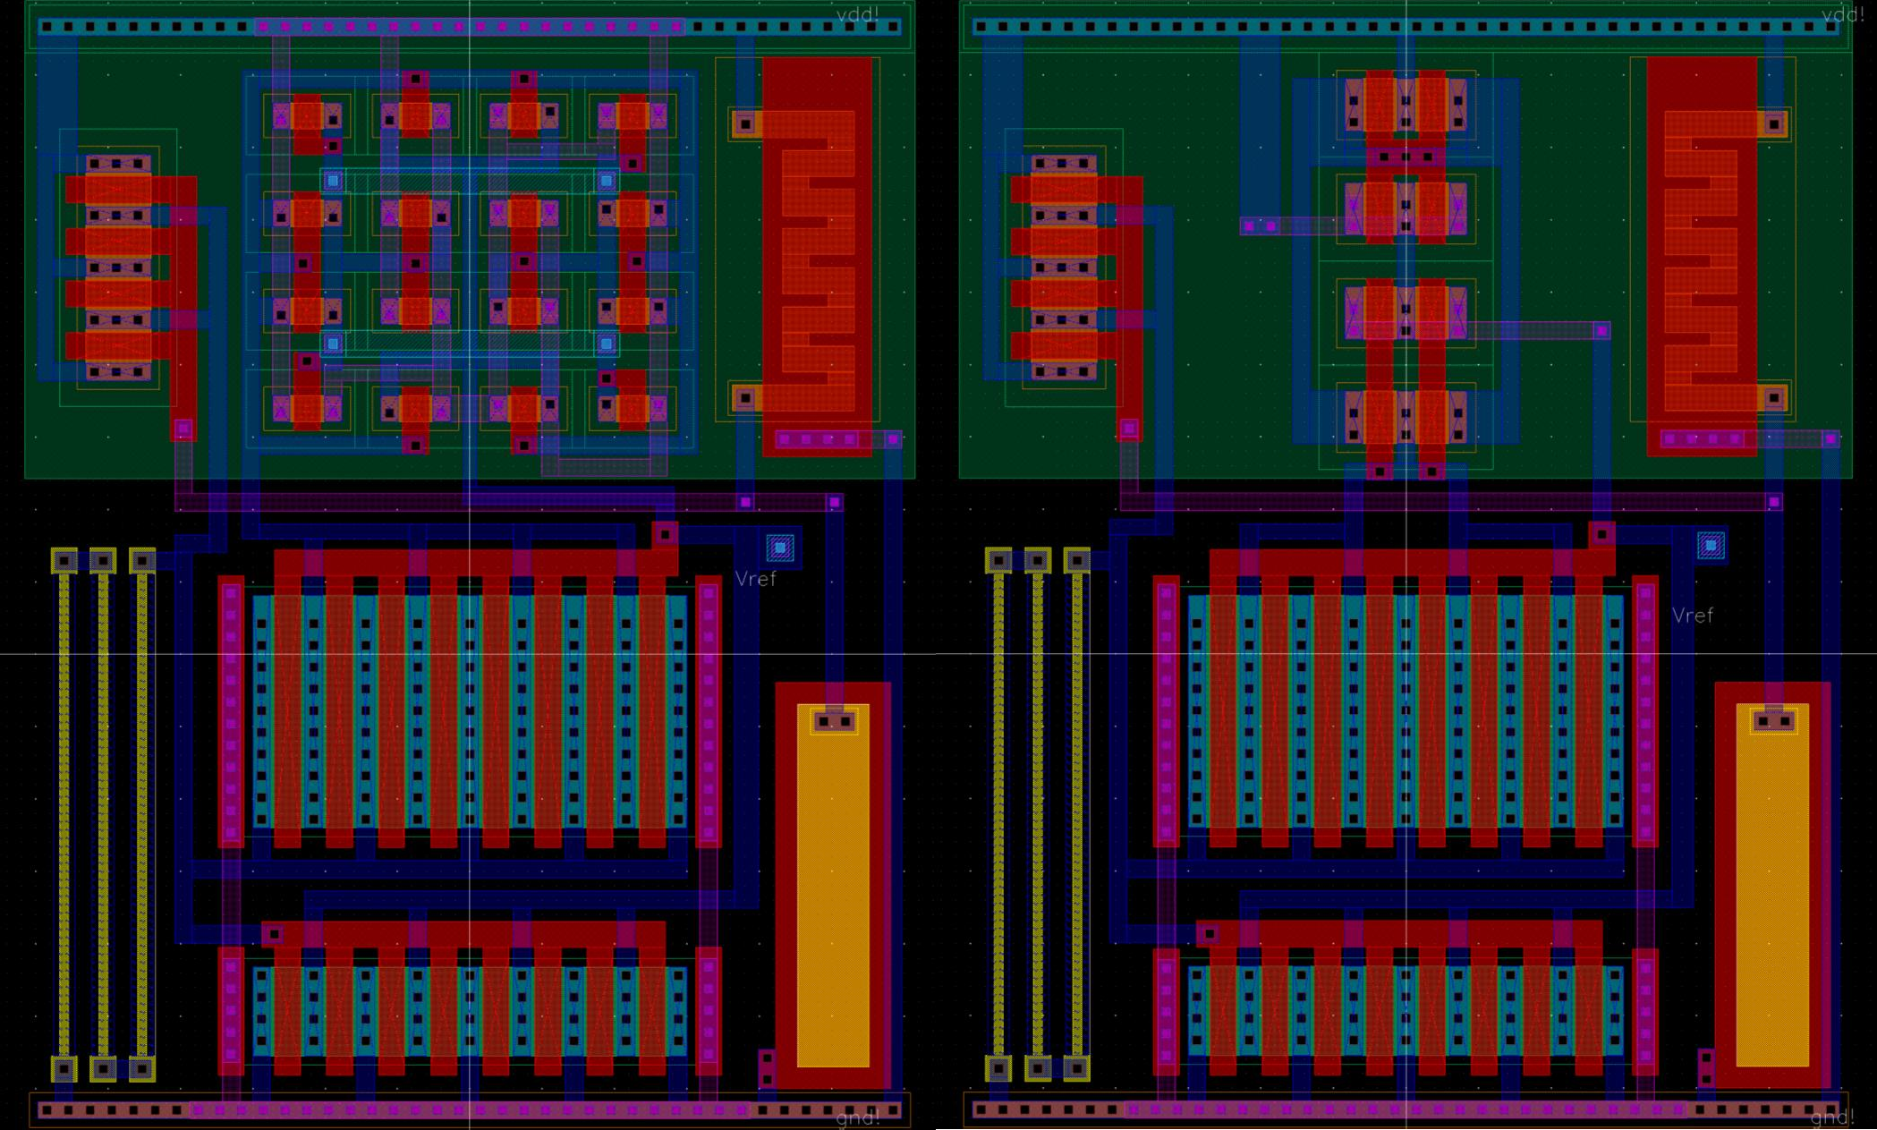
Voltage reference LAYOUT
BIAS PSRR
BIAS transient I
BIAS transient II
Reference design I
Reference design II
Reference design III
Reference DC Sim I
Reference DC Sim II
Reference T Sweep
Reference Line Reg
Reference PSRR
Reference Tran I
Reference Tran II
Reference Layout I
As mentioned, two layout version have been implemented. The difference is only about the cascode current mirror. It will be discussed in a subsequent slide.
The total area is the
same for both the cells:
≈ 4787 𝜇𝑚²
Centroid
Classic

Slide 45
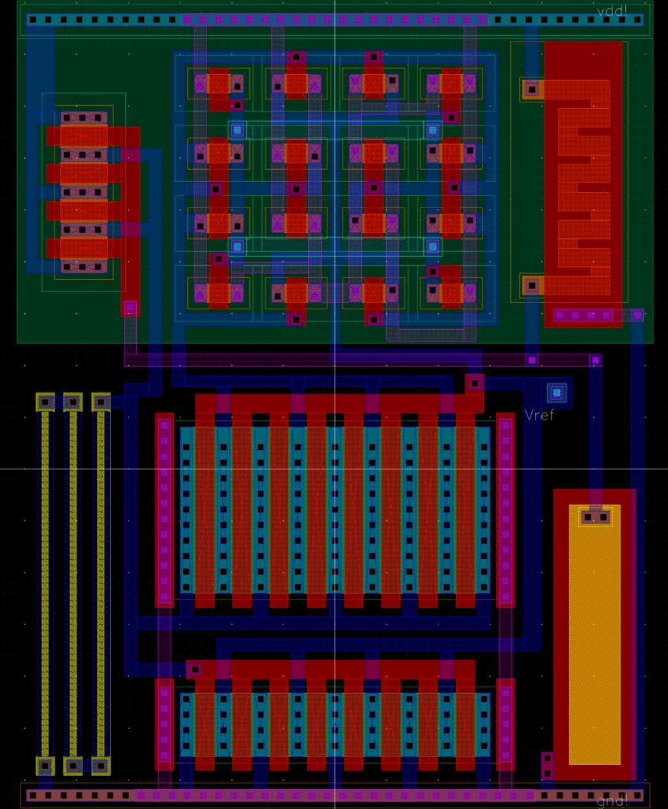
LAYOUT - Common parts
BIAS transient I
BIAS transient II
Reference design I
Reference design II
Reference design III
Reference DC Sim I
Reference DC Sim II
Reference T Sweep
Reference Line Reg
Reference PSRR
Reference Tran I
Reference Tran II
Reference Layout I
Reference Layout IIv

Slide 46
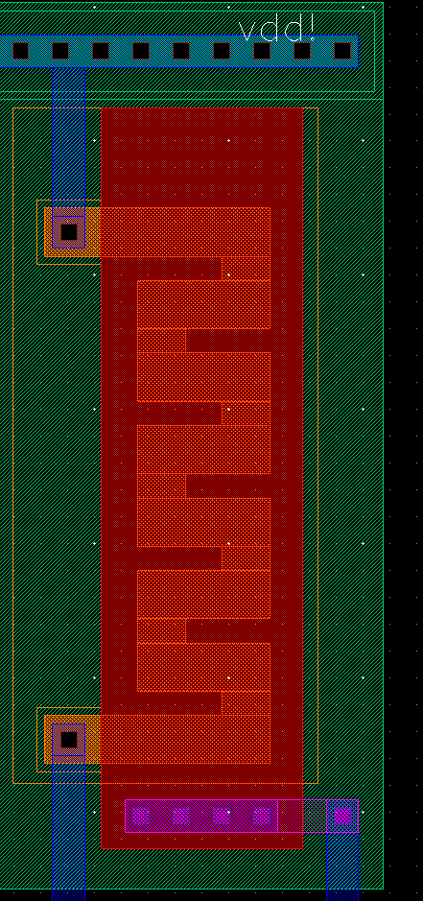
BIAS transient II
Reference design I
Reference design II
Reference design III
Reference DC Sim I
Reference DC Sim II
Reference T Sweep
Reference Line Reg
Reference PSRR
Reference Tran I
Reference Tran II
Reference Layout I
Reference Layout II
Reference Layout III
LAYOUT - Long transistor design
In a classic BULK CMOS process the transistor width is usually defined by the active and the channel length is set by the poly which covers the active and select during the drain/source implantation process. Here the opposite process is exploited to fabricate a long channel transistor in a smaller area. The width is given by the active thickness and the poly covers everything but the drain and source regions.

Slide 47
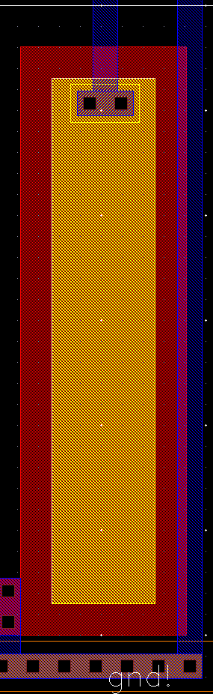
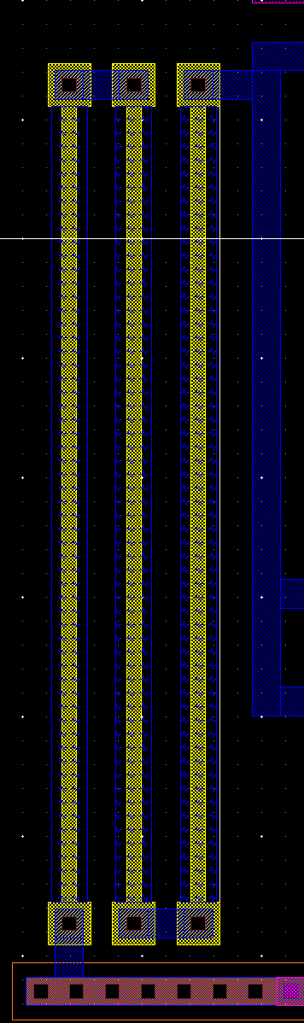
LAYOUT - Resistors and capacitors
Reference design II
Reference design III
Reference DC Sim I
Reference DC Sim II
Reference T Sweep
Reference Line Reg
Reference PSRR
Reference Tran I
Reference Tran II
Reference Layout I
Reference Layout II
Reference Layout III
Reference Layout IV
Reference Layout V
Precision resistor with poly2 HiRes: this implementation comes with multiple advantages with respect to a N-WELL resistor, e.g. less parasitic capacitance due to larger and isolated distance from bulk, smaller area due to unnecessary insulation junction around it or an even larger sheet resistance (1076 ^{Ω}Τ∎).
Precision capacitor with poly/poly2: as for the poly2 resistors one of the advantage of this capacitor implementation is the separation from bulk which can be easily source of noise. Moreover an etched layer fabrication should be more precise than an implantation based one. Here the real capacitor area is given by the poly2 layer and the extracted value is around 90 fF.

Slide 48
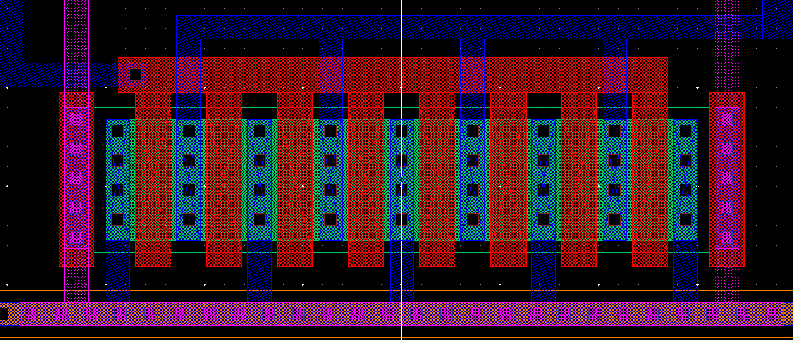
LAYOUT – Interdigitated structures
Reference design I
Reference design II
Reference design III
Reference DC Sim I
Reference DC Sim II
Reference T Sweep
Reference Line Reg
Reference PSRR
Reference Tran I
Reference Tran II
Reference Layout I
Reference Layout II
Reference Layout III
Reference Layout IV
The large MOS is split into 8 smaller transistors with alternated drain and source implants. It follows that the multiple transistors show a sum of parasitic capacitance which should be lower than the equivalent single device. Here a couple of dummy gates have been attached to the extremities of the structure to let the last implants see the same neighbourhood of any other.
These two additive gate are GND connected.

Slide 49
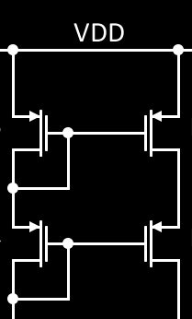


Reference design II
Reference design III
Reference DC Sim I
Reference DC Sim II
Reference T Sweep
Reference Line Reg
Reference PSRR
Reference Tran I
Reference Tran II
Reference Layout I
Reference Layout II
Reference Layout III
Reference Layout IV
Reference Layout V
A
B
LAYOUT – Cascode current mirror
D
C
Here comes the main difference between the two proposed layouts.
A 2D common centroid structure with 16 transistors 1.8 𝜇𝑚 large makes use of 3 metal layers but allows an enhanced symmetry for temperature gradients cancelling in both directions. The second structure is simpler and does not require a third metal layer which in this case shall correspond to one less mask to be processed. Moreover, it is potentially less area consuming even if in this specific layout the cell width is imposed by the NMOS transistors.
A
C
C
B
A A
D
A
B
D
B B
D
B
A
D
C C
B
C
C
A
D D

Slide 50

EXTRACTED Transient Simulation
Reference design III
Reference DC Sim I
Reference DC Sim II
Reference T Sweep
Reference Line Reg
Reference PSRR
Reference Tran I
Reference Tran II
Reference Layout I
Reference Layout II
Reference Layout III
Reference Layout IV
Reference Layout V
Ref extracted Tran
For comparison purposes could be useful to report here the schematic level start-up time previously obtained:
NOTE: both the start-up times have risen but an increase of the difference between them can be denoted too. This could be caused by the larger amount of wirings needed in the common centroid structure.
Classic: ≈ 97 𝜇𝑠
Centroid: ≈ 98 𝜇𝑠
As the markers show the time increased a lot but this was expected due to the real wiring and parasitic of a layout level simulation. The result is now:
Classic: ≈ 286 𝜇𝑠
Centroid: ≈ 295 𝜇𝑠

Slide 51

EXTRACTED PSRR Simulation
Reference DC Sim I
Reference DC Sim II
Reference T Sweep
Reference Line Reg
Reference PSRR
Reference Tran I
Reference Tran II
Reference Layout I
Reference Layout II
Reference Layout III
Reference Layout IV
Reference Layout V
Ref extracted Tran
Ref extracted PSRR
Comparing schematic vs. extracted simulations results, the latter behave better on the peak part and worst at higher frequencies.
NOTE: the Centroid version presents the same behaviour of a larger capacitance on the output node compared with the Classic one (smoother HF PSRR)
Schematic simulation results:
Classic peak: -12.6 dB
Centroid peak: -13.3 dB
DC PSRR: -43.4 dB
Classic HF PSRR: -24.8 dB
Centroid HF PSRR: -24.3 dB

Slide 52


Complete system DC simulation
Reference DC Sim II
Reference T Sweep
Reference Line Reg
Reference PSRR
Reference Tran I
Reference Tran II
Reference Layout I
Reference Layout II
Reference Layout III
Reference Layout IV
Reference Layout V
Ref extracted Tran
Ref extracted PSRR
Full DC Sim
Here the complete designed circuit is tested when the load sinks the maximum current (2 mA) and when the load current is negligible. All the blocks are schematic level implementation except for the
“referenceCCentroidGen” one.
@ 2 mA
The output voltage is correct when the current reaches its limit.
The high impedance DC simulation allows a quiescent
current estimation which is about 28 𝜇𝐴. Since the total current budget was set to 30 𝜇𝐴 the specification has been satisfied.
@ Hi Load

Slide 53

Complete system Line Regulation
Reference T Sweep
Reference Line Reg
Reference PSRR
Reference Tran I
Reference Tran II
Reference Layout I
Reference Layout II
Reference Layout III
Reference Layout IV
Reference Layout V
Ref extracted Tran
Ref extracted PSRR
Full DC Sim
Full Line Reg
The system starts to regulate the output voltage when VDD is above 3.7 V.

Slide 54

Complete system Load Regulation
Reference Line Reg
Reference PSRR
Reference Tran I
Reference Tran II
Reference Layout I
Reference Layout II
Reference Layout III
Reference Layout IV
Reference Layout V
Ref extracted Tran
Ref extracted PSRR
Full DC Sim
Full Line Reg
Full Load Reg
The variation due to load is:
3.337 − 3.313
∗ 100 = 0.72%
3.337
So the output voltage changes less the 1% when the current demand is increased up to its design limit.

Slide 55

Complete system Transient simulation
Reference PSRR
Reference Tran I
Reference Tran II
Reference Layout I
Reference Layout II
Reference Layout III
Reference Layout IV
Reference Layout V
Ref extracted Tran
Ref extracted PSRR
Full DC Sim
Full Line Reg
Full Load Reg
Full Transient I
The plot shows that the start-up time of the complete device is driven by the voltage reference circuit.
Elongation due to low output node capacitance
The BIAS circuit (red line) is ready after about 6 𝜇𝑠 and before this moment the regulator output (yellow line) is pulled up by the PMOS pass-transistor. But when the BIAS is ready, the differential amplifier inside the LDO can start working and takes down 𝑉_{𝑟𝑒𝑔} since its inverting input is connected to the resistors divider at an higher voltage with respect to the non-inverting one.
NOTE: a low pass filter on the reference voltage output could smooth the system response and maybe improve PSRR too.

Slide 56

Complete system PSRR @ 23pF CL
Reference Tran I
Reference Tran II
Reference Layout I
Reference Layout II
Reference Layout III
Reference Layout IV
Reference Layout V
Ref extracted Tran
Ref extracted PSRR
Full DC Sim
Full Line Reg
Full Load Reg
Full Transient I
Full PSRR I
The final PSRR performances are:
-37 dB @ DC
-39 dB @ High frequency
2.5 dB peak @470 MHz
The last parameter is an issue due to the inverted phase at the same very frequency.
It was an expected result since it comes out from the LDO PSRR original behaviour.

Slide 57

Complete system PSRR @ 100nF CL
Reference Tran II
Reference Layout I
Reference Layout II
Reference Layout III
Reference Layout IV
Reference Layout V
Ref extracted Tran
Ref extracted PSRR
Full DC Sim
Full Line Reg
Full Load Reg
Full Transient I
Full PSRR I
Full PSRR II
One could think about placing an external capacitor which would make the system always stable with respect to the supply noise. The plot shows a PSRR starting from a -37 dB DC level and improving with frequency growth.

Slide 58
Reference Layout I
Reference Layout II
Reference Layout III
Reference Layout IV
Reference Layout V
Ref extracted Tran
Ref extracted PSRR
Full DC Sim
Full Line Reg
Full Load Reg
Full Transient I
Full PSRR I
Full PSRR II
Final outcomes
Project outcomes
The presented device seems to be compliant with all the design specifications.
It shows very good Load and Line regulation (less than 1%) and drives a relatively large current.
Its weakness is about the middle frequency (around 500 𝑘𝐻𝑧) PSRR which shows a positive gain with inverted phase. Increasing the internal compensation capacitor seems to be not enough to stabilise it. Indeed, the peak is attenuated but remains positive with capacitance greater then 30 𝑝𝐹.
An alternative to the integration of a huge capacitor is to consider an external output capacitor which would lead to a stable PSRR at any frequency.
A second possibility is to change a little bit the topology as the reference article authors did. Let’s try to explore this second approach…

Slide 59

The modified topology is shown here and presents two main changes:
the capacitors have been moved in the centre of the cascode current mirror;
the cascode transistors width has been increased to get a larger gain which amplifies the compensation capacitance leading to better PSRR performances.

Slide 60

The phase margin results to be higher than before, moving from 61 dB to 65 dB.
The plot refers to an isolated analysis of the LDO schematic.

Slide 61

The PSRR is finally negative even when it reaches its peak value.
The last step is to simulate the entire system with the new topology to confirm the result…

Slide 62

And with the present plot the behaviour can be confirmed for the final circuit too.
The resulting peak
PSRR is:
-5 dB @930 kHz

Slide 63
Thank you for your attention.

